Slide 1
Unleash your inner hero!
ORGAN DONOR
ENROLLMENT DAY
OCTOBER 7, 2021
DIGITAL TOOLKIT

Slide 2
ENROLLMENT DAY
DIGITAL TOOLKIT
The Organ Donor Enrollment Day digital tool kit provides resources for LiveOnNY partners to educate, inform and inspire their community, their staff and the general public about the power of organ, eye and tissue donation. Together, we can sign up organ donors and save more lives!
The initiative is meant to bring hope to the nearly 10,000 New Yorkers currently waiting for a lifesaving organ transplant.

Slide 3
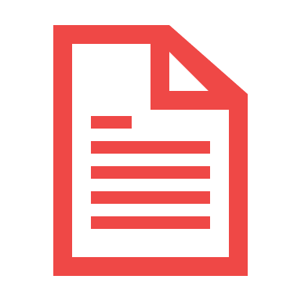
This kit offers res.
THE KEY TO SUCCESS
OUR PARTNERS ARE KEY TO HELPING SAVE MORE LIVES!
With the event going digital, every opportunity and every touch point where we can provide education about donation is key to the success of the day.
HELP US AMPLIFY
Leverage all communication channels to provide education and sign up organ donors with the materials provided in this tool kit. Materials include:
Email & Newsletter Copy
Tabling
Educational Materials
Social Media, Text
& Blogs
Videos
Graphics: Posters, Screensavers, Flyers
INSPIRE ENROLLMENT & TRACK YOUR PROGRESS
Partners will be provided a unique link to track enrollments. Partners with the most enrollments in their respective category will receive a plaque.
SIGN UP ORGAN
DONORS ONLINE

Slide 4
Email Copy
Subject: Save Lives on Organ Donor Enrollment Day!
On Thursday October 7th, [insert organization name] will be joining forces with LiveOnNY to make a difference in the lives of New Yorkers.
Did you know that nearly 10,000 children and adults in New York are currently waiting for a lifesaving organ transplant? These are our friends, family, and neighbors who need our help. Every day, a New Yorker dies because the transplant they needed did not come soon enough.
To help change this, we will join LiveOnNY and hundreds of others for New York’s seventh annual Organ Donor Enrollment Day. It’s a single to day to ask everyone to consider becoming a lifesaving organ donor. It’s easy to do online and only take a couple of minutes.
Consider signing up as a lifesaving organ donor and encourage friends and family to do the same. Together we can help save even more lives! Click on the below link and take 2 minutes to help. One organ donor can save up to eight lives!
[insert your organization’s unique registration link]
Reminder Email:
Subject: It’s Not Too Late to Save Lives
The seventh annual Organ Donor Enrollment Day is on Thursday, October 7th. Thank you for helping us to bring hope to the 10,000 New Yorkers currently waiting for a life-saving transplant. Take a moment out of your day to sign up as an organ donor and help save lives. Click on the below link and take 2 minutes to sign up.
Sign-up today at [insert your organization’s unique registration link].
One organ donor can save up to eight lives!
EMAIL COPY

Slide 5
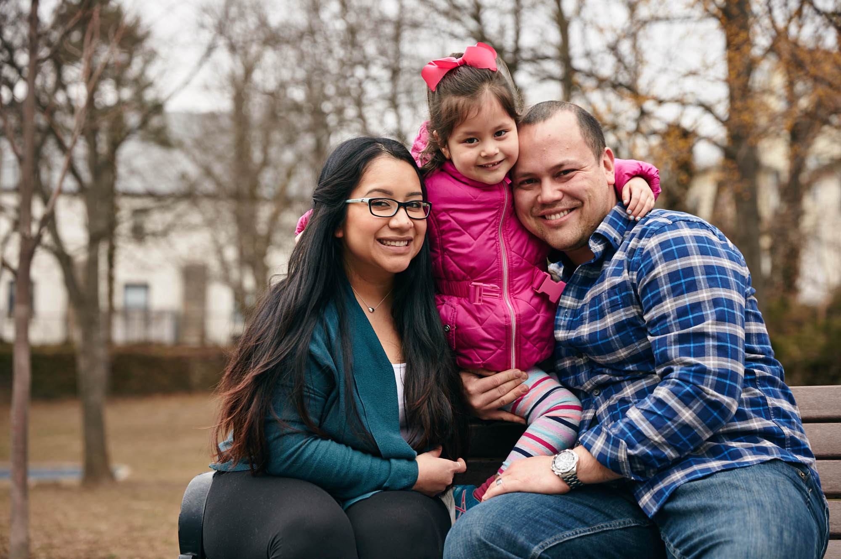
Organ Donor Enrollment Day: A Day to Inspire New York to Sign Up to Save Lives
New York, NY- Did you know that nearly 10,000 children and adults in New York are currently waiting for a lifesaving organ transplant? These are our friends, family, and neighbors and they need our help. October 7 is Organ Donor Enrollment Day, a day focused on creating awareness on the importance of organ donation so that more New Yorkers will be encouraged to take action and sign up as organ donors.
Currently, New York has a shortage of donated organs which means those who need transplants, have longer wait times to get the help they need. We can restore hope to those who wait by saying yes to organ donation. Here are some things to keep in mind:
The Facts About Saving Lives
Organ donation is often possible even with certain health conditions.
There is no age limit to be an organ donor - the oldest donor in New York was 93 years old.
The organ donation process follows strict guidelines to ensure fairness and equity.
Because organ donation saves lives, most religions celebrate it as a final act of kindness.
Registering as an organ donor does not change your medical care. Doctors and medical staff are legally obligated to save your life.
In 2016 Lauren was first listed for a heart transplant. 5 years later and she is still waiting for a lifesaving transplant. Each day the list of things she can no longer do with her family continues to grow. Yet, she remains resilient and strong in her fight for her family and most of all for her young daughter Sophia. Lauren is one of the thousands of New Yorkers waiting for a lifesaving transplant. Register as an organ and tissue donor at [insert your organization’s unique registration link] and bring hope to those waiting. One organ donor can save up to eight lives.
NEWSLETTER COPY

Slide 6
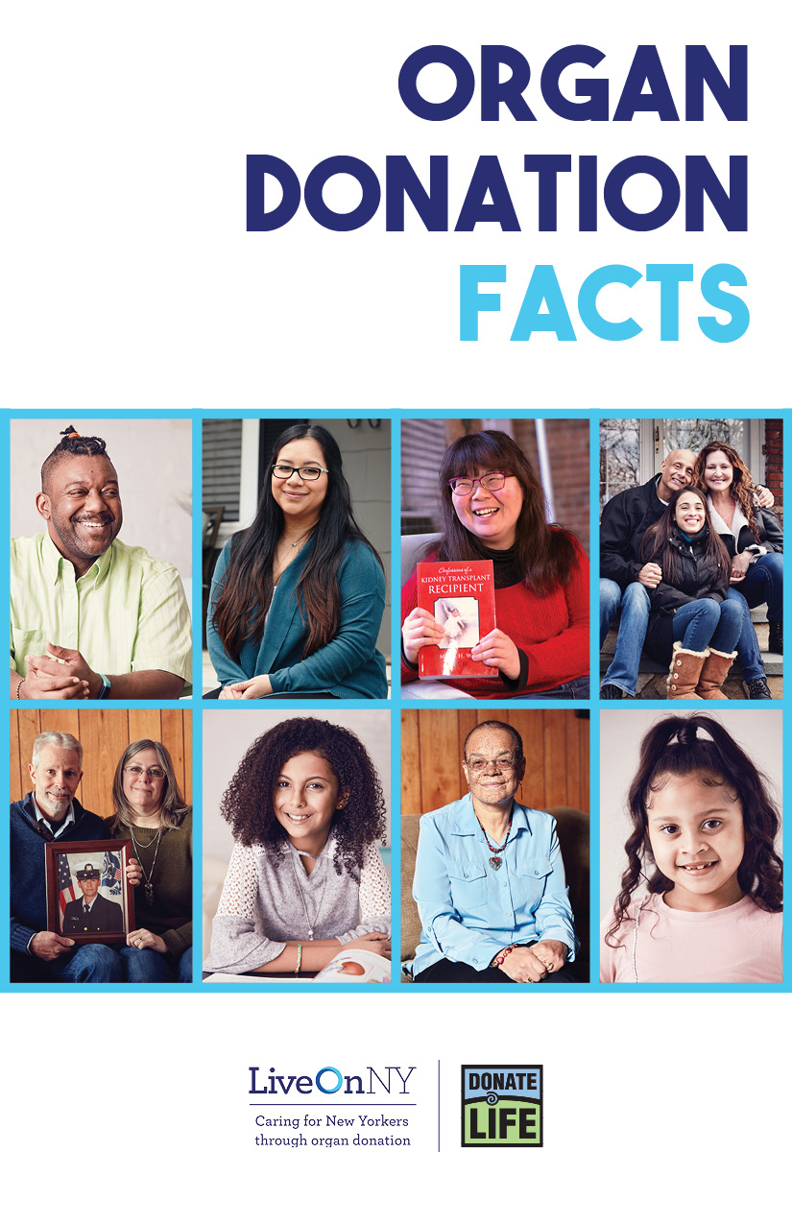
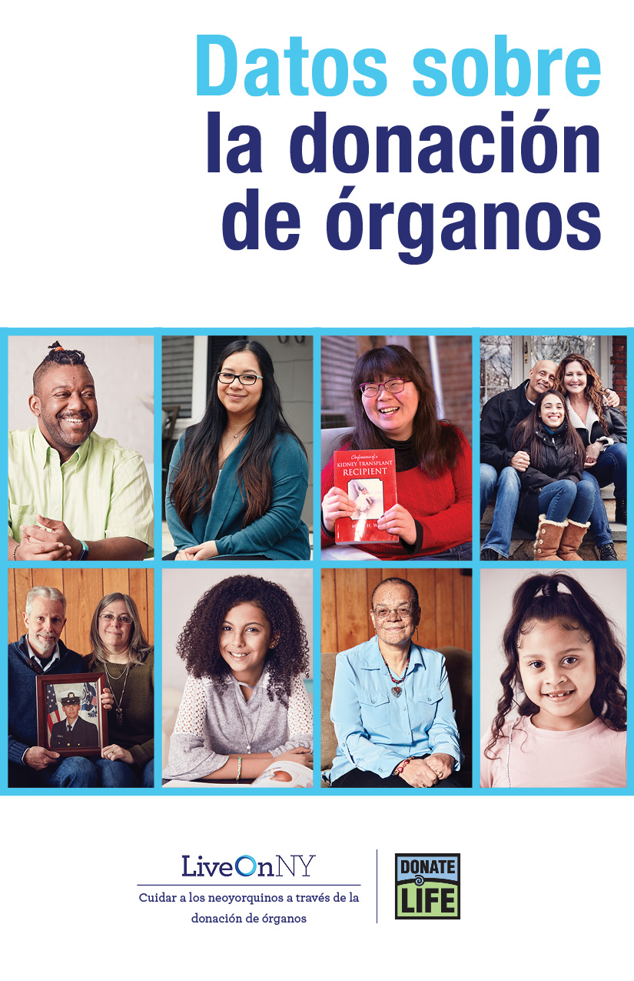
EDUCATIONAL MATERIALS
Fact Sheet
FAQs
Stat Sheet
Facts in
English
Facts in Spanish

Slide 7
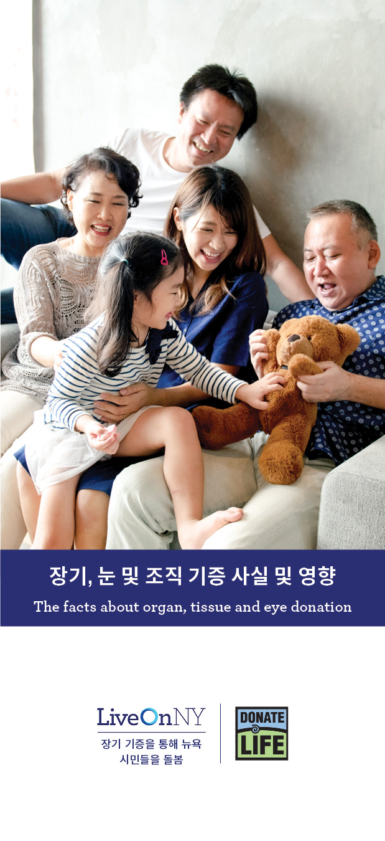
English
Spanish
Russian
Chinese
Korean
EDUCATIONAL MATERIALS BROCHURES
Reform
Judaism
Conservative
Judaism
Orthodox
Judaism
Catholic
Black Community

Slide 8
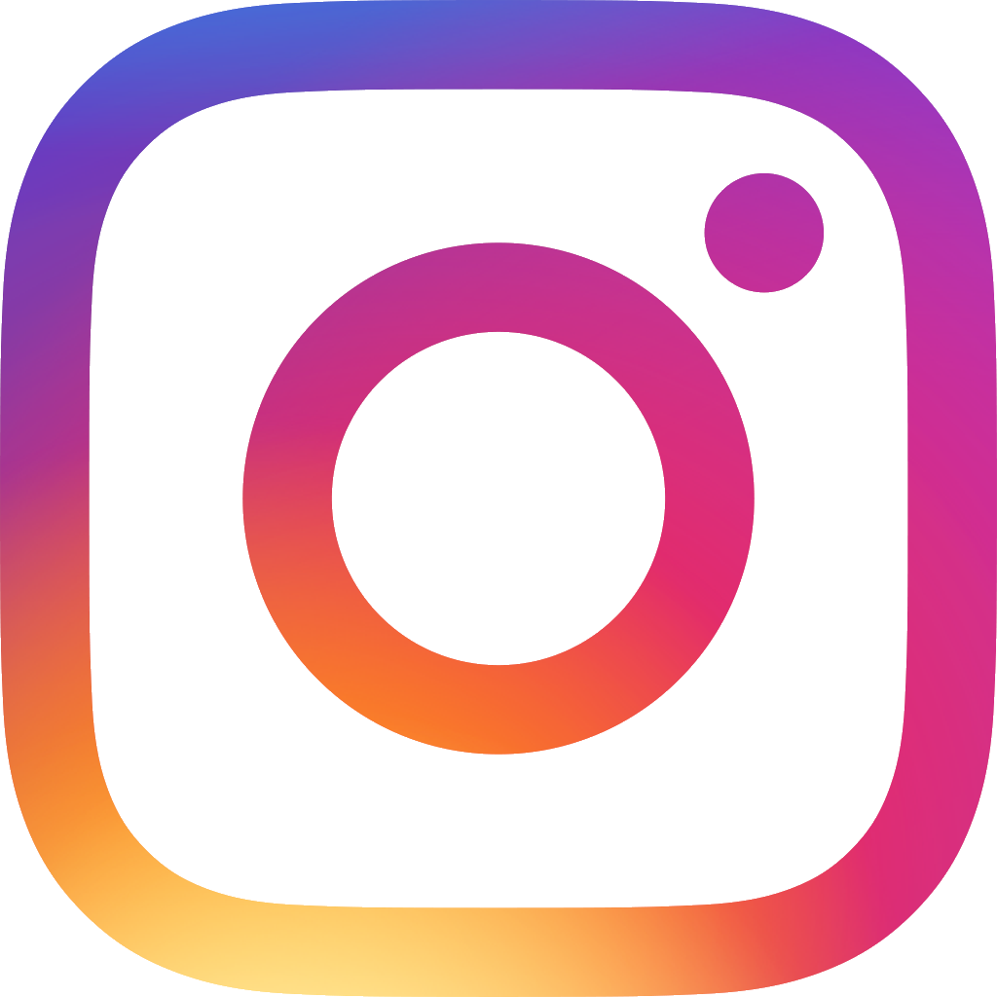
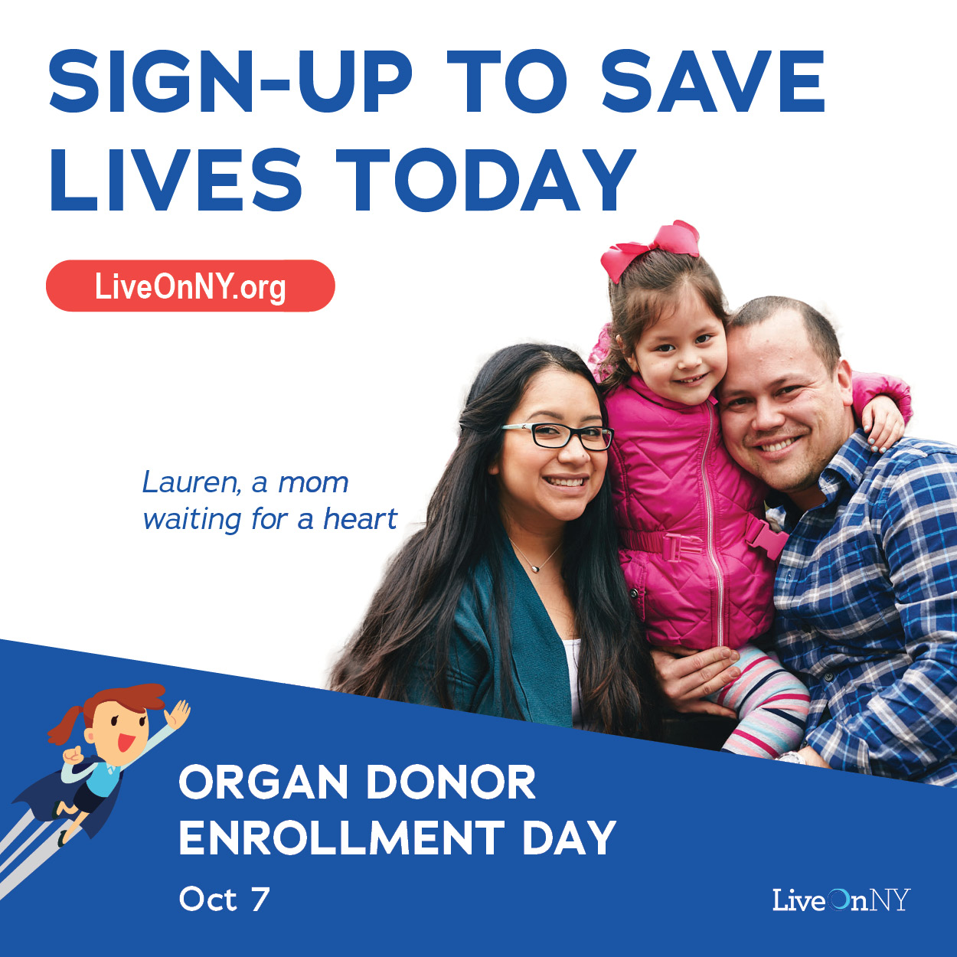
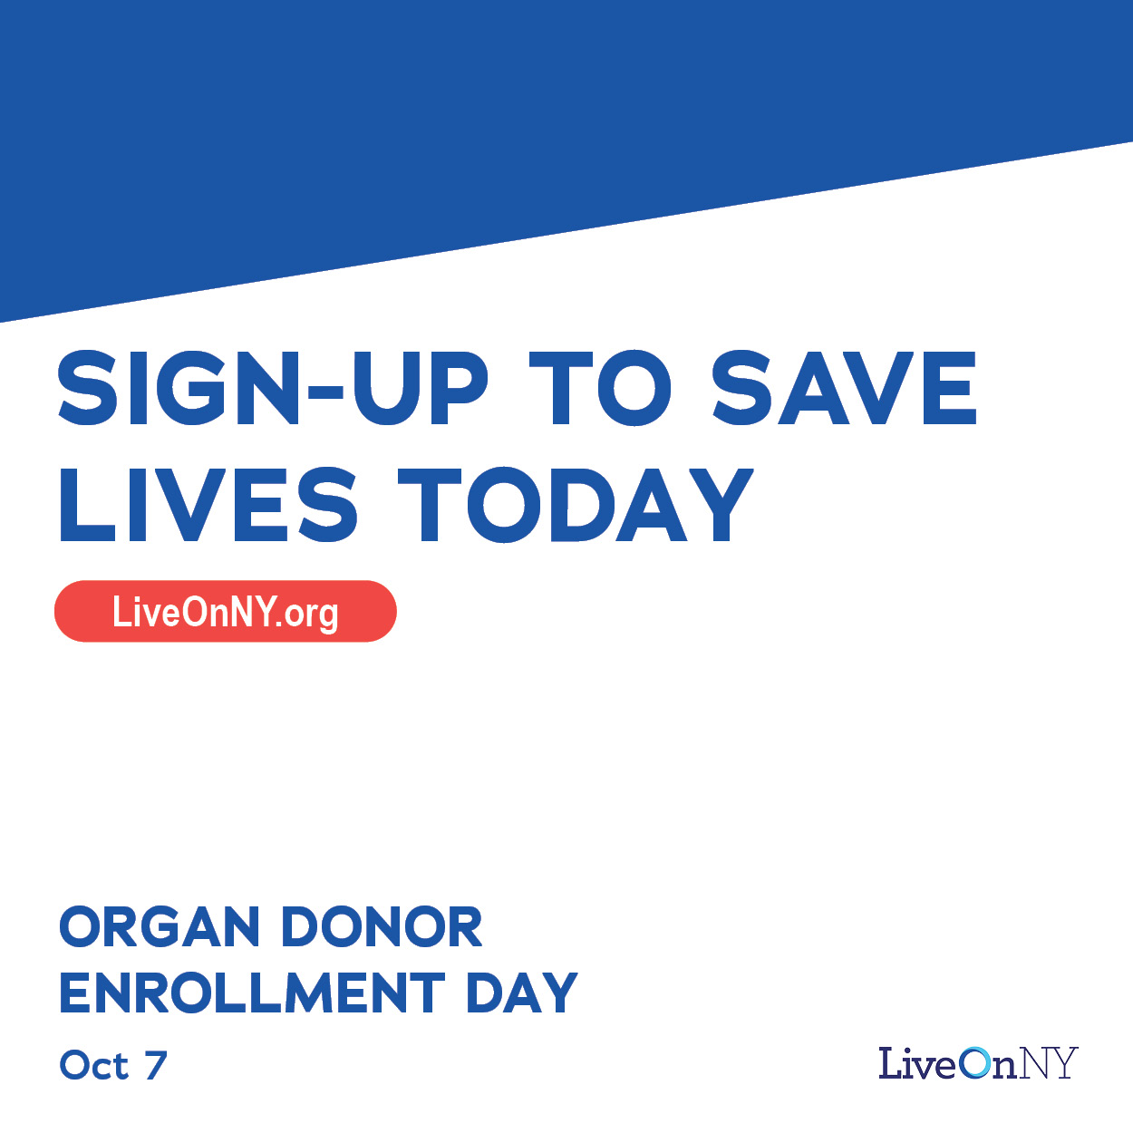
Instagram/Facebook
Every day a New Yorker dies waiting for a transplant. Help change that by signing up as an organ donor. Registerme.org/EnrollmentDay #DonorDay2021
SOCIAL MEDIA
#DonorDay2021
Every day a New Yorker dies waiting for a transplant. Help change that by signing up as an organ donor. Registerme.org/EnrollmentDay #DonorDay2021

Slide 9
Twitter
Every day a New Yorker dies waiting for a transplant. Help change that by signing up as an organ donor. Registerme.org/EnrollmentDay #DonorDay2021
SOCIAL MEDIA
#DonorDay2021
Help save up to 8 lives by registering as an organ donor. Organ Donor Enrollment Day is 10/7. Registerme.org/EnrollmentDay #DonorDay2021
It’s Organ Donor Enrollment Day, and our staff, in collaboration with @LiveOnNewYork, is educating New Yorkers about organ & tissue donation. #DonorDay2021

Slide 10
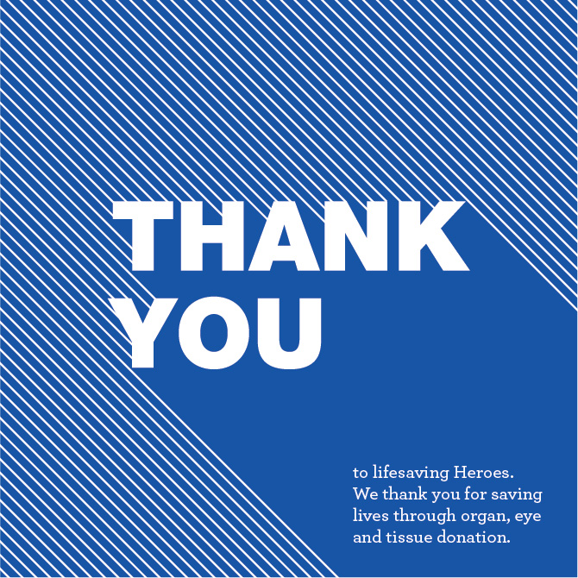
Thank Participating Partners on Social Media Channels
Thank you to everyone that helped to make LiveOnNY's annual Organ Donor Enrollment Day a success! You are all amazing advocates, and we couldn't have done it without you. We came together to educate New Yorkers about the power of organ, eye, and tissue donation and to sign up lifesaving organ donors. #DonorDay2021
SOCIAL MEDIA
THANK YOU MESSAGE
Thank you to everyone that helped to make LiveOnNY's annual Organ Donor Enrollment Day a success! You are all amazing advocates, and we couldn't have done it without you. We came together to educate New Yorkers about the power of organ, eye, and tissue donation and to sign up lifesaving organ donors. #DonorDay2021
Thank you to everyone that helped to make LiveOnNY's annual Organ Donor Enrollment Day a success! You are all amazing advocates, and we couldn't have done it without you. We came together to educate New Yorkers about the power of organ, eye, and tissue donation and to sign up lifesaving organ donors. #DonorDay2021

Slide 11
Lauren was just 28 years old and the news hit her and her family hard.
"I never thought it would get this bad,” Lauren says. “Honestly, a transplant was never even on the radar. My dad never cries, but I remember him crying when I told him I needed a new heart."​
Lauren and her family have no idea when — or if — she'll get the heart she needs.​
​
"The doctors tell me it could be tomorrow, or it could be a couple years," she says. "I just hope that it comes in time."​
​
The pandemic has only made waiting harder. Lauren’s father used to visit her daily and help around the house and play with Sophia, but quarantine restrictions and Lauren’s vulnerability to disease has forces those visits to become virtual. Meanwhile, Lauren's health is declining.
“The list of things I am no longer able to physically do has grown quite a bit,” she says. “Cooking has always been something I find a lot of joy in and unfortunately it has become too much for me. I attempted to go for a short walk with Sophia recently and was able to only walk about a block. I had to stop three times because of chest pain.”
Through it all, Lauren remains hopeful.
“Although physically I feel pretty terrible, mentally I know that I am strong enough to get through this,” she says. “I have faith that my perfect heart will find its way to me when the time is right. The transplant would mean a new life for me and my family.”
​
Today is Organ Donor Enrollment Day, a day dedicated to inspiring New Yorkers to sign up as an organ donor. One organ donor can save up to eight lives and give someone like Lauren a second chance at life.
​
Sign up online by clicking here: [insert your organization’s unique registration link]​
A New Heart Would Mean More Time With Her Daughter
2016. The year Lauren was first listed for a heart transplant. 5 years later Lauren is still waiting for a transplant and the list of things she can no longer do continues to grow. Yet, she remains resilient and strong in her fight for her family and most of all for her young daughter Sophia.
Lauren’s heart issues started in middle school. She was in gym class jumping rope when she suddenly went into cardiac arrest. She was just 12 years old.
“All I remember is waking up in the ambulance,” she says.​
​
She was soon diagnosed with hypertrophic cardiomyopathy (HCM), a genetic condition that prevents the heart from pumping enough blood. There is no cure for this disease and it has slowly worsened over the years. Growing up Lauren loved playing sports but the disease put a stop to all of that.
The disease seemed to be getting better in her 20s and Lauren got married and gave birth to her daughter, Sophia., but soon her body stopped responding to medication and she learned she would need a heart transplant to survive.
BLOG CONTENT

Slide 12
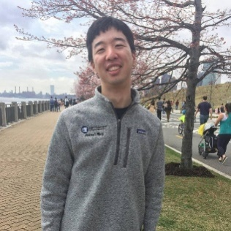
A Heart Donor Saved My Life and Changed My Family’s Perspective On Organ Donation
When I left my fifth-grade classroom for a routine doctor’s visit I had no reason to think that I wouldn’t be back the next day. Things were looking up for my family and me. My parents had immigrated from China in the 1980s and had finally managed to find stable footing in the US. We purchased a home in a quiet suburb and my sister and I were looking forward to our future. That was all about to change.
While checking my heart, the doctor heard an abnormal rhythm. After a whirlwind of meetings with medical personnel filled with scary questions, I was diagnosed with idiopathic dilated cardiomyopathy. To this day, nobody knows what the cause was. No one in my family had ever had a history of heart disease.
I remember asking the nurse if I would need a heart transplant. At the time, I wasn’t sure if that was even the right word. The nurse tried to reassure me, but I could tell she was shaken and worried for my future.
I was rushed to my local hospital and then airlifted overnight to a teaching hospital far from my home. I was admitted to the ICU a few days before Christmas. A hospital Santa visited me and asked me what I wanted for Christmas. I told him all I wanted was a new heart. I remember him smiling sadly at my request.
The next few months were among the hardest in my life. My parents and sister moved closer to the hospital and my mother spent every night sleeping in my hospital room. My prognosis was so bad that the Make-A-Wish Foundation got in touch to see if they could grant me a final wish. I was only ten years old, but I understood how grim things were.
One fateful day a miracle happened, and the doctors told me I had matched with a heart donor. The next day I underwent a lifesaving operation and soon I was on the road to recovery. I am here today thanks to my incredible heart donor.
I often reflect on just how lucky I was to receive my transplant when I did. While I was in the hospital, I met another young Chinese boy my age. Our families quickly bonded because of our similar situations. He waited much longer for his transplant and during that time had a stroke that paralyzed one side of his body. Many patients die waiting for a lifesaving transplant.
My transplant journey had a huge impact on me and today I am an MD/PhD student in New York City. My research focuses on engineering biomaterials for drug delivery and regenerative medicine. My eventual goal is to be a practicing cardiologist so that I can help patients both in the present and the future.
It has been 15 years since my transplant and I still take immunosuppressive medications and regularly visit my cardiologist, but I live an otherwise normal life. This is all thanks to the incredible generosity of a stranger who gave me his heart when I needed it most.
Not everyone is as lucky as I am. There is a huge shortage of organ donors, especially in the Chinese community. Before my hospitalization my parents were very skeptical about registering to be organ donors because of the questionable practices and cultural attitudes about donation back in China. My transplant journey changed their minds and taught us how important it is to be an organ donor. I encourage everyone to learn more about the power of organ, eye and tissue donation and to consider signing up to be a lifesaving organ donor.
BLOG CONTENT

Slide 13
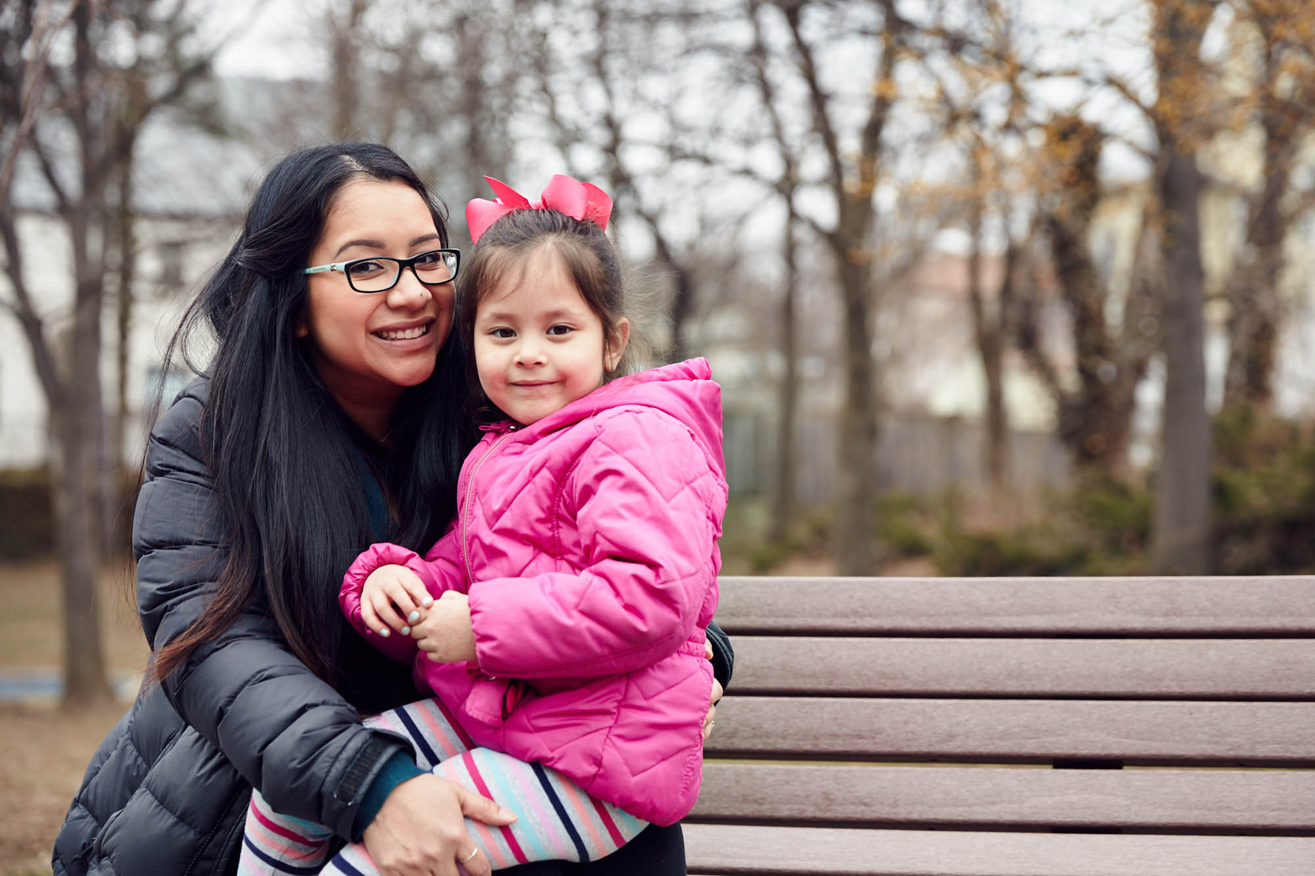
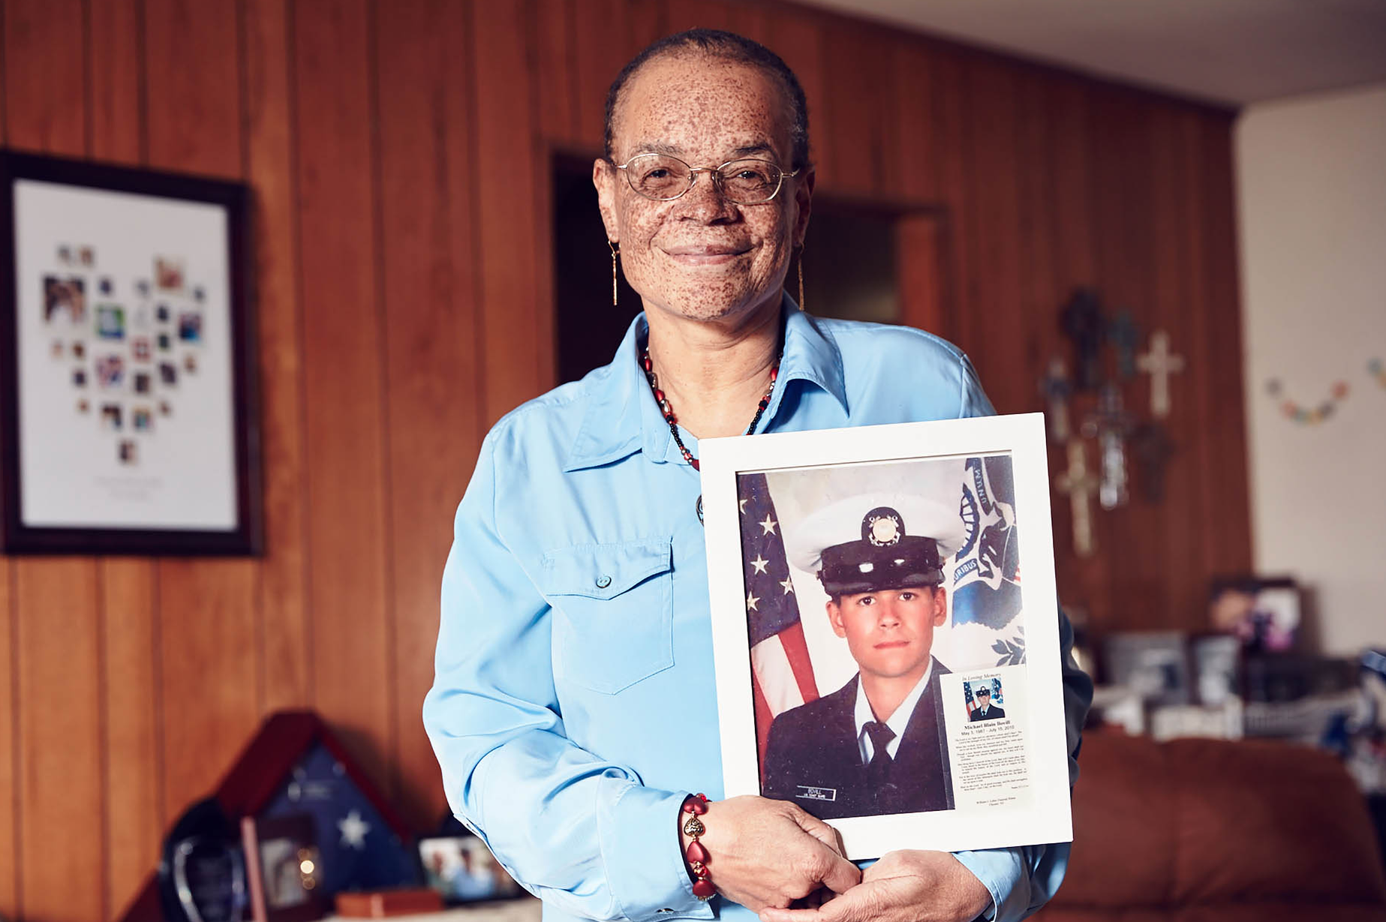
Lauren is a young mom waiting for a heart transplant. A new heart would mean more time with her daughter.
LiveOnNY dispels common myths and misconceptions about organ, eye and tissue donation.
VIDEOS
Michael was an organ donor and saved 5 lives including Roxanne’s. She received Michael’s heart and honors his legacy through organ donation advocacy work.
This HRSA video explains the transplant waiting list, how someone becomes a donor and the process of matching organs.

Slide 14
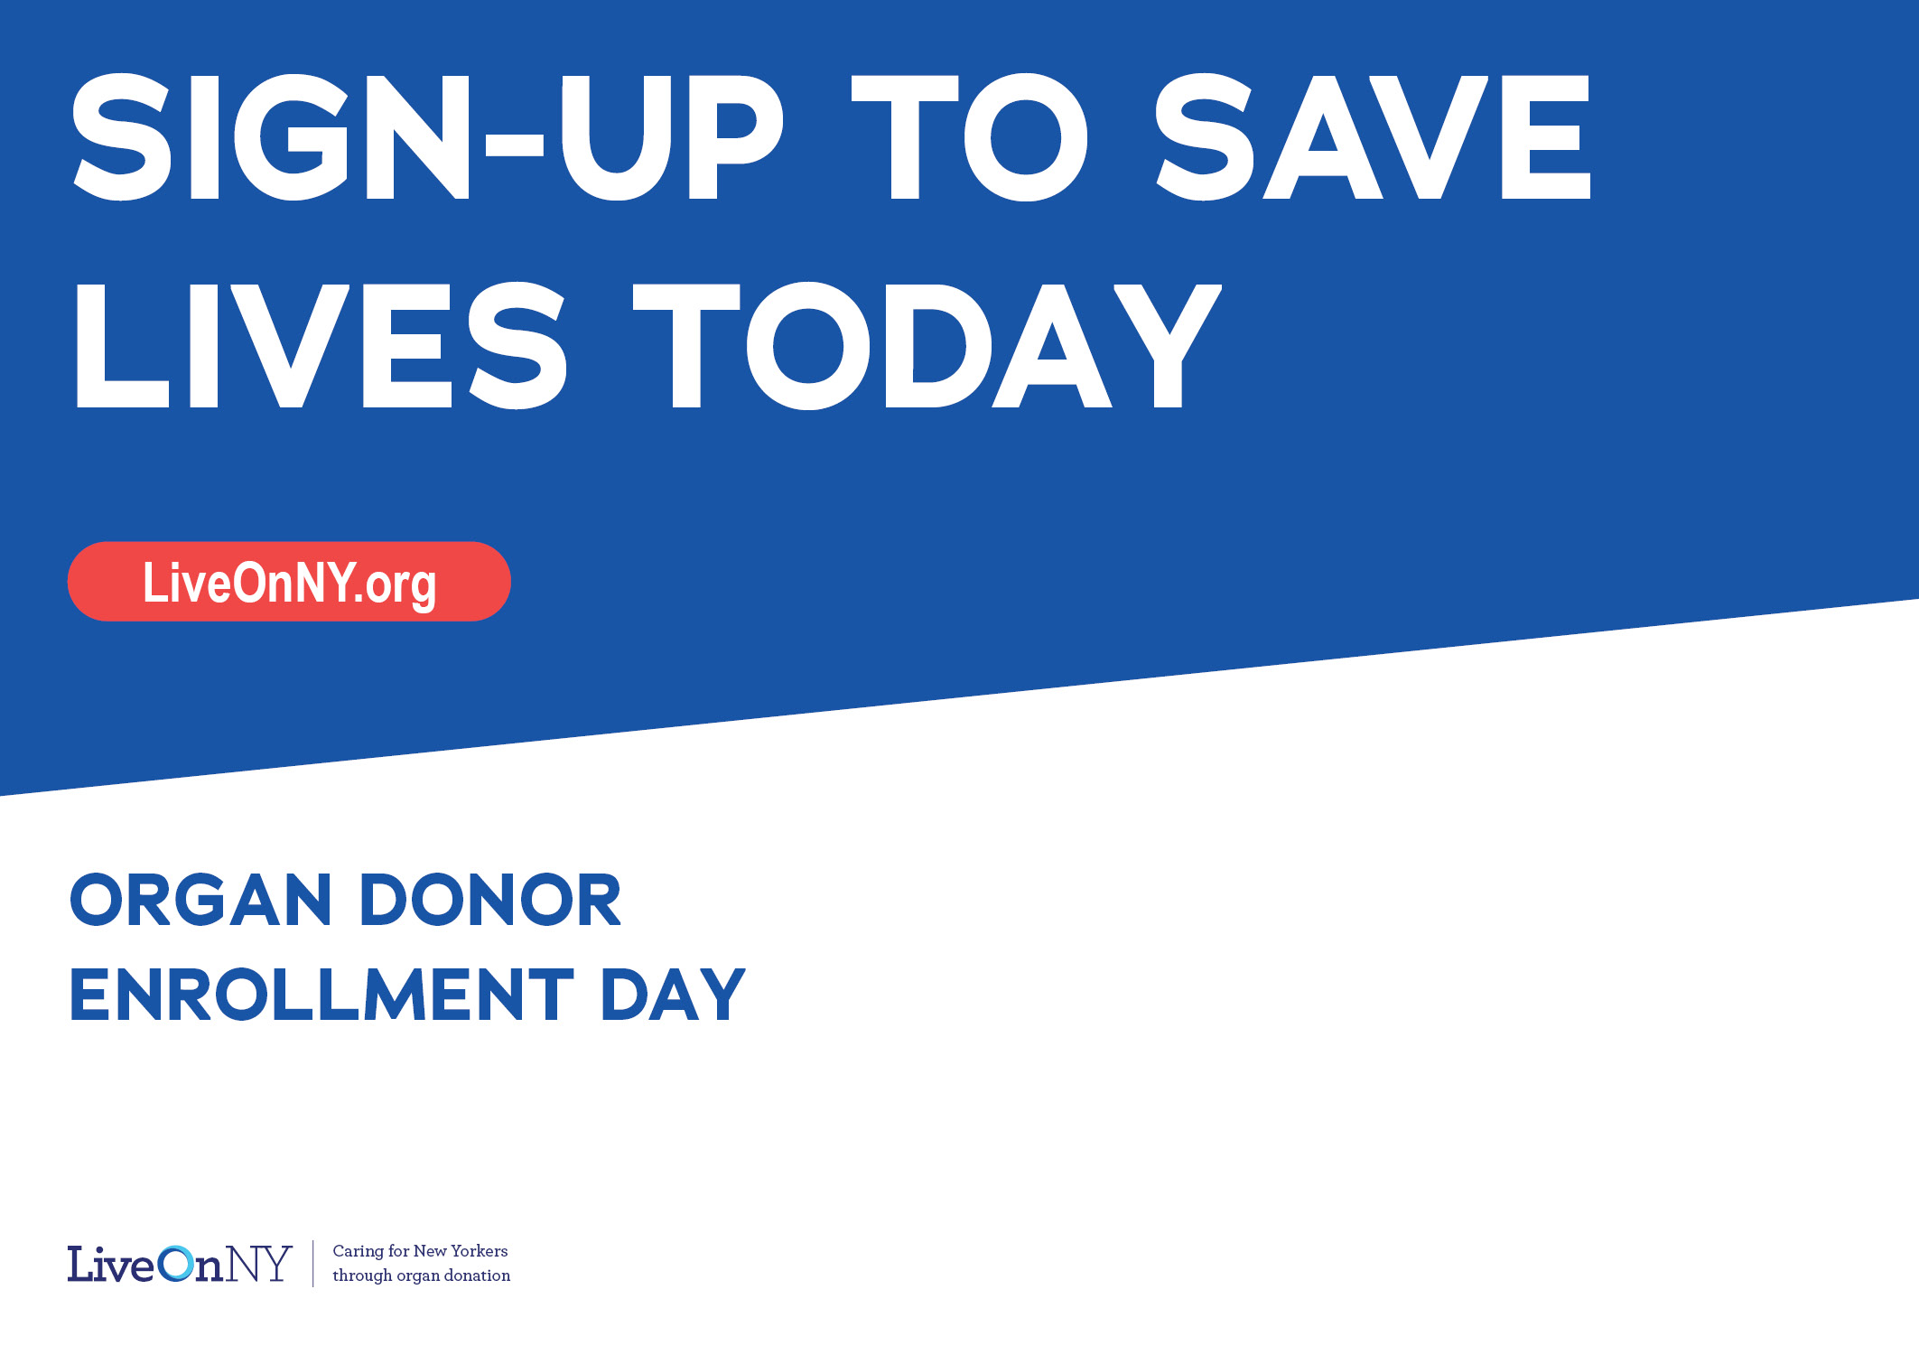
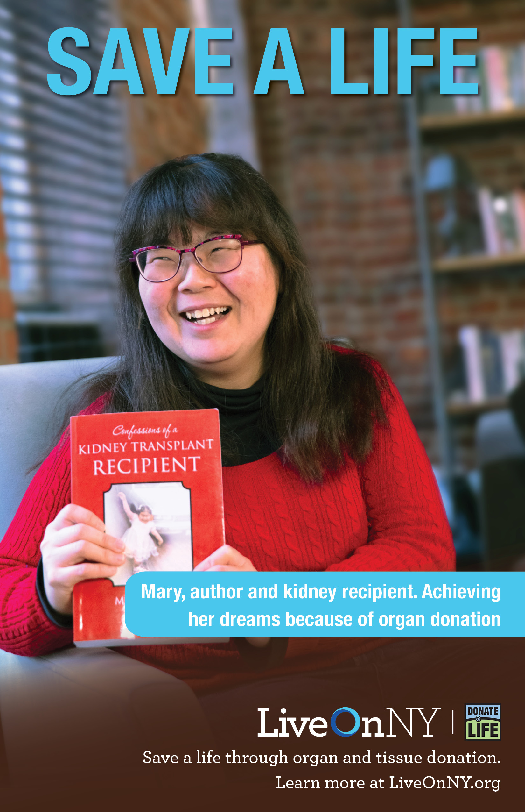
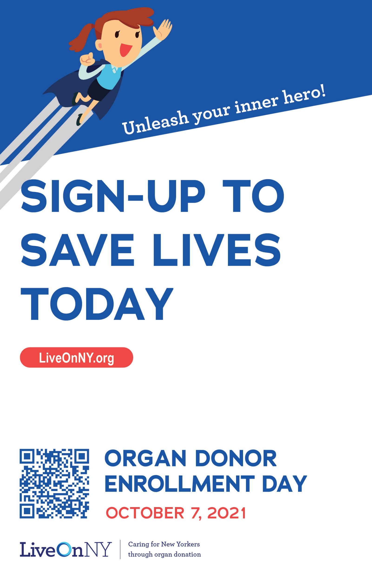
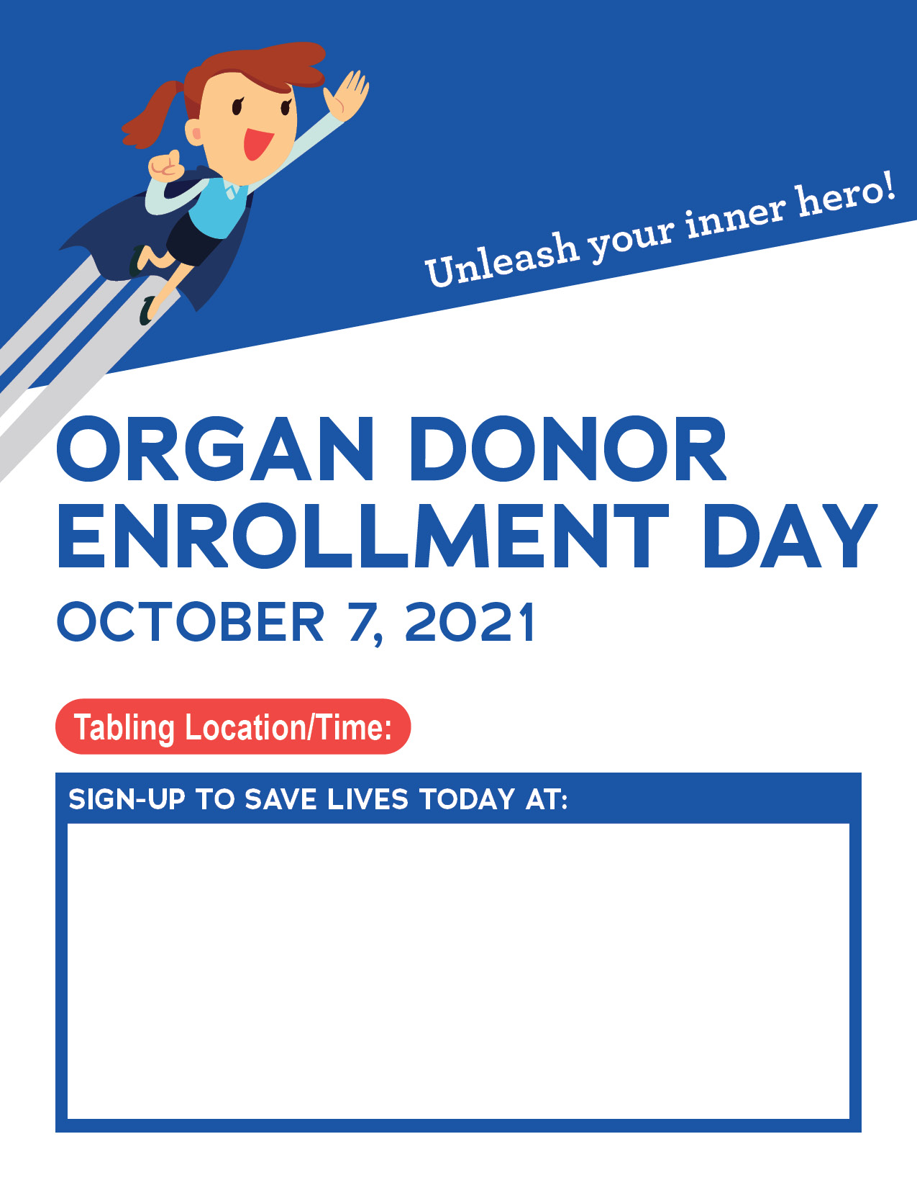
Screensavers
Zoom Backdrop
GRAPHICS/ZOOM BACKDROPS
Posters
Customizable Flyers

Slide 15
GET CREATIVE
INSPIRE PEOPLE TO ENROLL


Send out a message from the CEO (email, video posted to intranet, tweet)
Create a friendly competition with another participating team
Offer a longer lunch hour: an extra break to save lives
Host an Instagram takeover or a twitter chat
Host an educational webinar or learning opportunity
Share information about donation in breakrooms, on units

Slide 16
Unleash your inner hero!
THANK YOU!
EnrollmentDay.org
For more information,
contact Safiya Raheem at sraheem@liveonny.org

