Slide 1
Unleash your inner hero!
DONATE LIFE MONTH 2021: GARDEN OF LIFE
A DIGITAL TOOLKIT

Slide 2
DONATE LIFE MONTH
DIGITAL TOOLKIT
ABOUT THE INITIATIVE
LiveOnNY is proud to partner with you to celebrate the lifesaving power of organ, eye, and tissue donation. This year’s Donate Life Month theme is “Garden of Life,” as it symbolizes hope, courage and transformed life — themes repeatedly found within the donation and transplantation journey.​
This digital tool kit provides turn-key resources for partners to help educate, inform and inspire their community, their staff and the general public about the power of organ donation. Together our work can help save more lives!
DONATE LIFE MONTH ACTIVATON OPTIONS:
Post about Donate Life Month on your social media channels
Send an email message to your staff, community and/or constituents
Publish an article in your newsletter or on your blog
Host an educational training for your staff, community and/or constituents led by LiveOnNY staff
Host or attend a flag raising ceremony to display the Donate Life flag in your district with a local hospital partner
Work with LiveOnNY to create a media moment and invite local press
Participate in National Blue & Green Day on April 16 by wearing and celebrating the colors of donation
Create chalk art to celebrate donation and inspire conversations
Paint a Donate Life rock and place it in your neighborhood for someone to discover
Write and present a proclamation to declare April 2021 as Donate Life Month
Display promotional posters or signage in support of donation
Host a Moment of Gratitude to honor the organ donors who gave the gift of life

Slide 3
This kit offers resources to amplify with the following pre-drafted copy, graphics and resources.
THANK YOU
THANK YOU TO OUR AMAZING PARTNERS!
Our partners help save lives through organ, eye and tissue donation. By helping to amplify the message of donation, you help inspire even more conversations about donation and help save more lives. Thank you for your continued support!
Below are options that can help amplify the message of donation during the month of April. This toolkit includes several communication channels and materials to provide education and information to your organization and community.
HELP US AMPLIFY
Social Media Content
Email & Newsletter Content
Graphics: Posters, Screensavers, Flyers
Educational Materials
Activity Ideas
Moment of Gratitude
INSPIRE ENROLLMENT
More registered organ donors means more lives saved. Be sure to offer the opportunity to sign up as a lifesaving organ donor in your outreach and communications. Use your unique Donate Life New York State registry link or link to LiveOnNY.org.
SIGN-UP ORGAN DONORS

Slide 4
SOCIAL MEDIA
#DonateLifeMonth #LiveOnNY

Slide 5
INSTAGRAM/FACEBOOK
Sample supporting text for graphics provided
April is National #DonateLifeMonth. There are 10,000 children & adults in NY waiting for a lifesaving transplant. Visit LiveOnNY.org
April is #DonateLifeMonth, let’s come together as a community to help others. Learn more at LiveOnNY.org. #DonateLifeMonth
One organ donor can save up to eight lives and improve the lives of more than 50 people. Register at LiveOnNY.org. #DonateLifeMonth
On average, 1 New Yorker dies every day waiting for a lifesaving transplant. Learn more at LiveOnNY.org. #DonateLifeMonth
This #DonateLifeMonth, talk to your family about your #organdonation wishes. Learn more at LiveOnNY.org #DonateLifeMonth
National Donate Life Blue & Green Day is on Friday, April 16. Show your Donate Life blue and green colors with pride! Share your photos with us by tagging #LiveOnNY and #BlueGreenDay #DonateLifeMonth
SOCIAL MEDIA
#DonateLifeMonth #LiveOnNY
This #DonateLifeMonth, talk to your family about your #organdonation wishes. Learn more at LiveOnNY.org #DonateLifeMonth

Slide 6
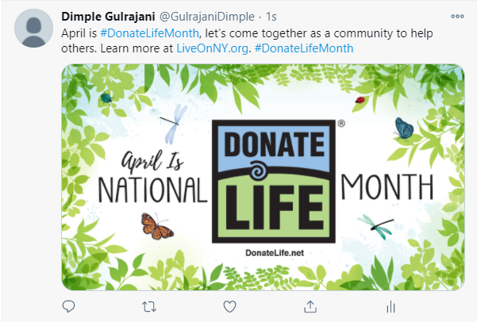
TWITTER
Sample supporting text for graphics provided
User Name
@Username
April is National #DonateLifeMonth. There are 10,000 children & adults in NY waiting for a lifesaving transplant. Visit LiveOnNY.org
It’s #DonateLifeMonth! Spread awareness about organ, eye and tissue donation. Register at: https://donatelife.ny.gov/ref/LiveOnNYlink/
April is #DonateLifeMonth, let’s come together as a community to help others. Learn more at LiveOnNY.org. #DonateLifeMonth
One organ donor can save up to eight lives and improve the lives of more than 50 people. Learn more at LiveOnNY.org. #DonateLifeMonth
On average, 1 New Yorker dies every day waiting for a lifesaving transplant. Learn more at LiveOnNY.org. #DonateLifeMonth
This #DonateLifeMonth, talk to your family about your #organdonation wishes. Learn more at LiveOnNY.org #DonateLifeMonth
SOCIAL MEDIA
#DonateLifeMonth #LiveOnNY

Slide 7
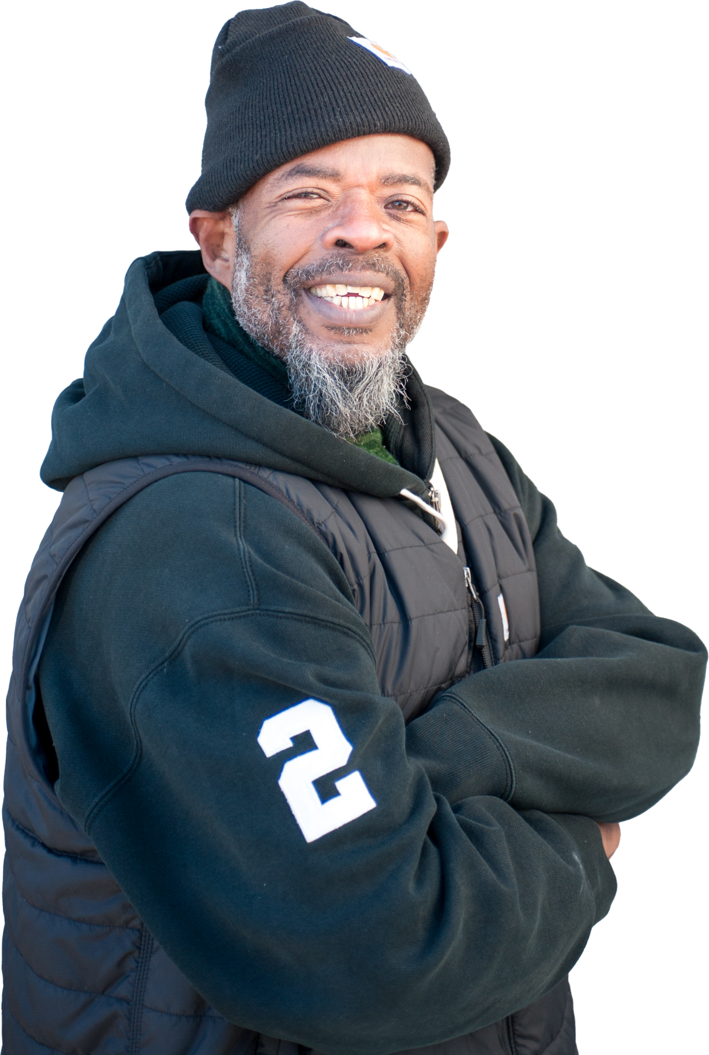
CHRISTOPHER, KIDNEY RECIPIENT
A Second Chance at Life
Christopher is unstoppable. Born with polycystic kidney disease, he knew from a young age that a kidney transplant was likely in his future. By 2015, his kidneys were failing and he was forced to go to dialysis three days a week. The appointments were so disruptive to his life that he was unable to work and had to move in with his mother. Through all of this, he was worried more about being too sick to care for his daughter and aging mother than he was for his own health.
After waiting nearly five years, Christopher received a lifesaving kidney transplant in October 2019. Since the surgery, everything has changed for Christopher. He began working at a hardware store in Brooklyn and got engaged. He was feeling good and his life was getting back on track when the pandemic struck. But it didn’t slow Christopher down. He continued to work hard to help his neighbors get the tools, supplies, and personal protective equipment (PPE) they needed at the store. He was also able to have a small, socially distanced wedding and has been enjoying life as a newlywed.
“I’m thankful every single day that I got a second chance at life,” he says. “I hope everyone who is waiting for an organ transplant is as lucky as me.”
To learn more about organ, eye, and tissue donation, please visit LiveOnNY.org.
BLOG CONTENT

Slide 8
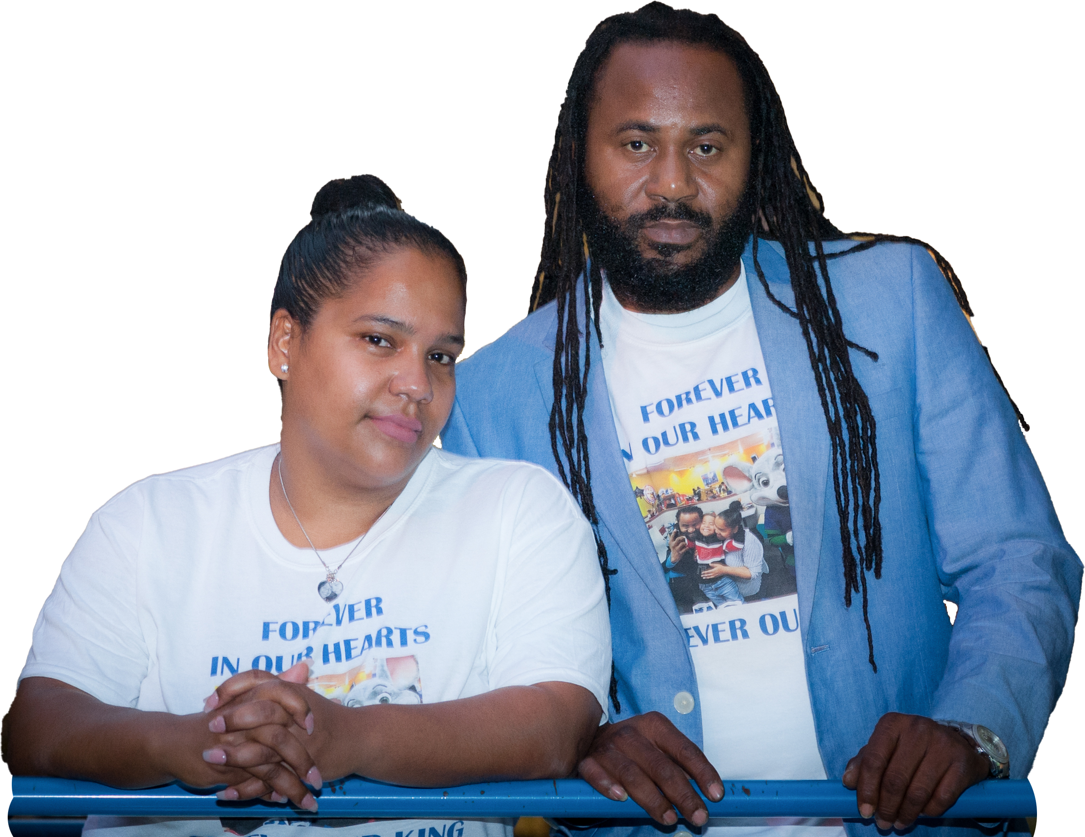
Kingston, Organ Donor
A Young Boy’s Lasting Legacy
Kingston was a curious and happy boy who touched all who knew him. He was born with Downs Syndrome, but that didn’t stop him from living life to the fullest. A Bronx resident, he was the joy of his parents' lives and a friend to his siblings and classmates.
Kingston tragically passed away in late 2019 at the age of seven after falling from the window of his apartment building. On the darkest day of their lives, his parents Rozzy and Steve were asked if they would donate the young boy’s organs so that others may live on. Without hesitation they said yes, and Kingston went on to save five lives.
“If you believe in God it’s OK to think about others, even in your worst moment,” Rozzy said, “Because that is the godly thing to do. There are people out there who don’t get the chance to see their kids reach even a month or a year. We had at least seven. Our son would have wanted to help others, so why not help?”
BLOG CONTENT
On the one-year anniversary of Kingston’s passing, his family hosted a memorial celebration for the young boy in the street outside of their home. Hundreds of people showed up to share memories of the young boy and participate in a balloon release in his honor.
“I want to keep my son’s legacy alive,” Rozzy said at the ceremony. “And I want to share how important it is for everyone to think about signing up to donate their organs.”
To learn more about organ, eye, and tissue donation, please visit LiveOnNY.org.

Slide 9
START A CONVERSATION
Sample text for TEXTING
April is National Donate Life Month. There are 10,000 children & adults in NY waiting for a lifesaving transplant. Visit LiveOnNY.org
This Donate Life Month, talk to your family about your #organdonation wishes. Learn more at LiveOnNY.org
One organ donor can save up to eight lives and improve the lives of more than 50 people. Register at: https://donatelife.ny.gov/ref/LiveOnNYlink/
On average, 1 New Yorker dies every day waiting for a lifesaving transplant. Learn more at LiveOnNY.org.
John Smith
TEXT MESSAGE
Hi John
There are nearly 10,000 New Yorkers in need of a lifesaving transplant. Sign up to save lives. Learn more at LiveOnNY.org.

Slide 10
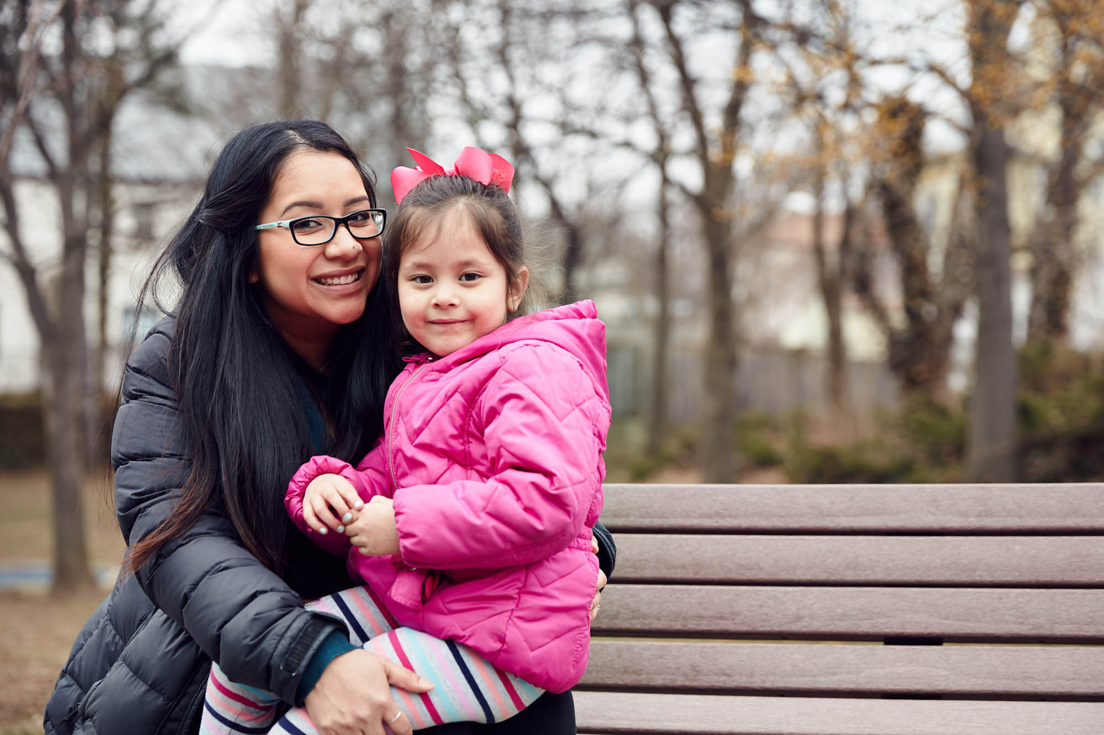
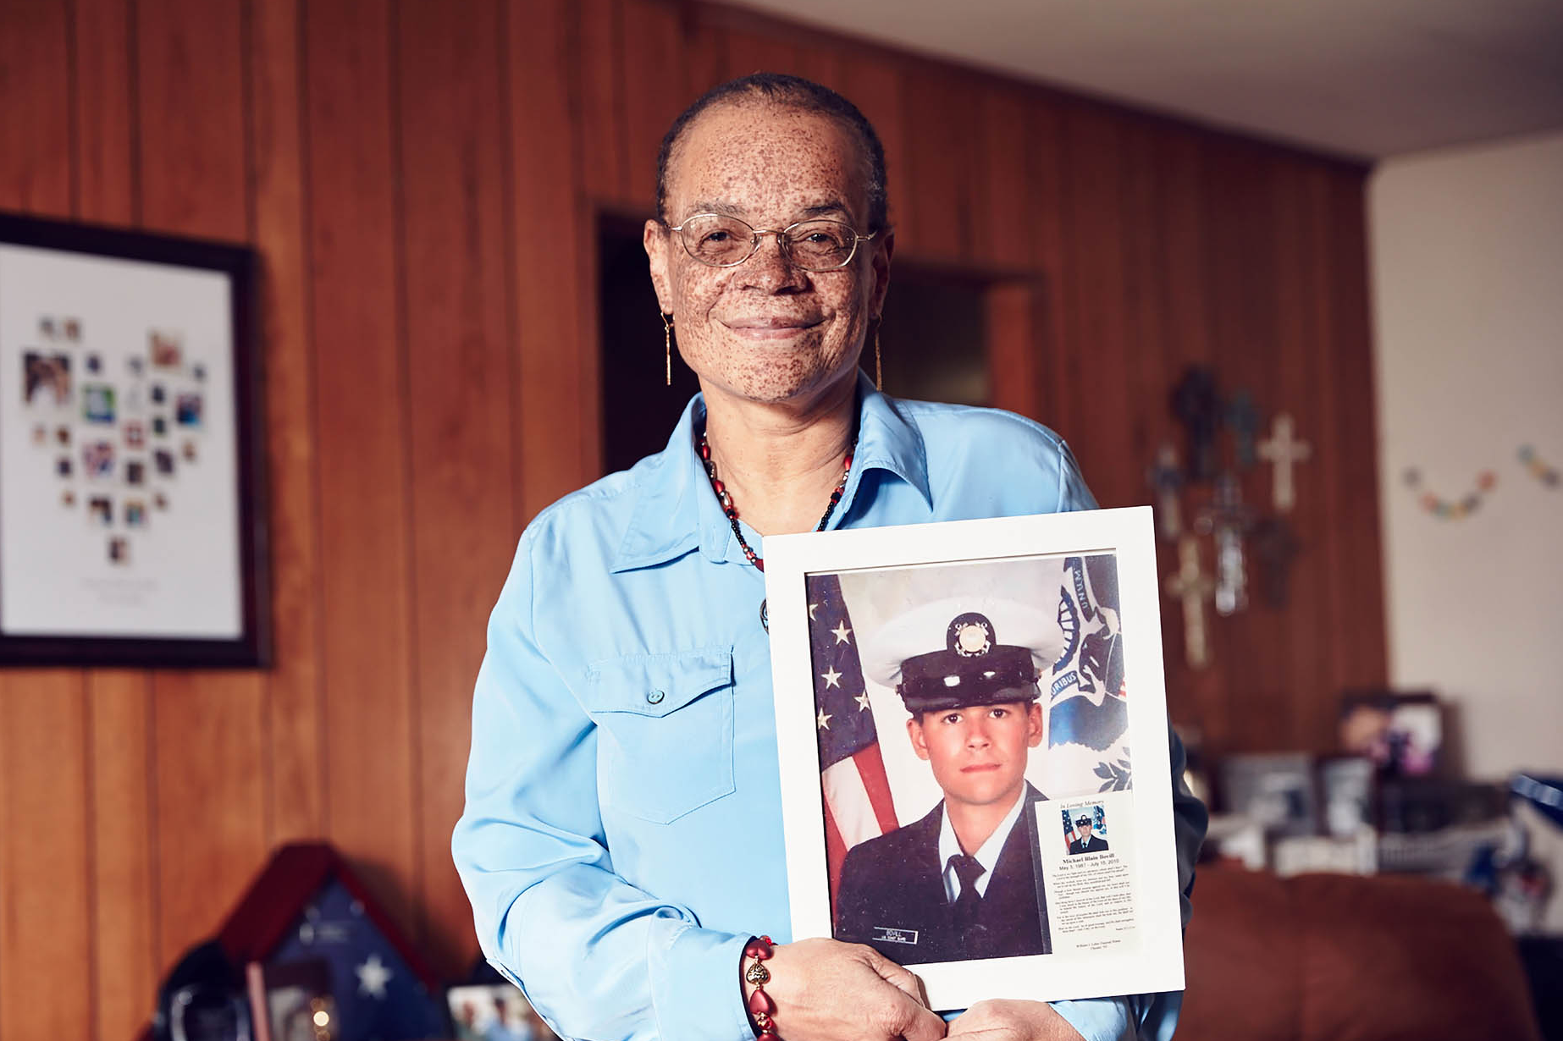
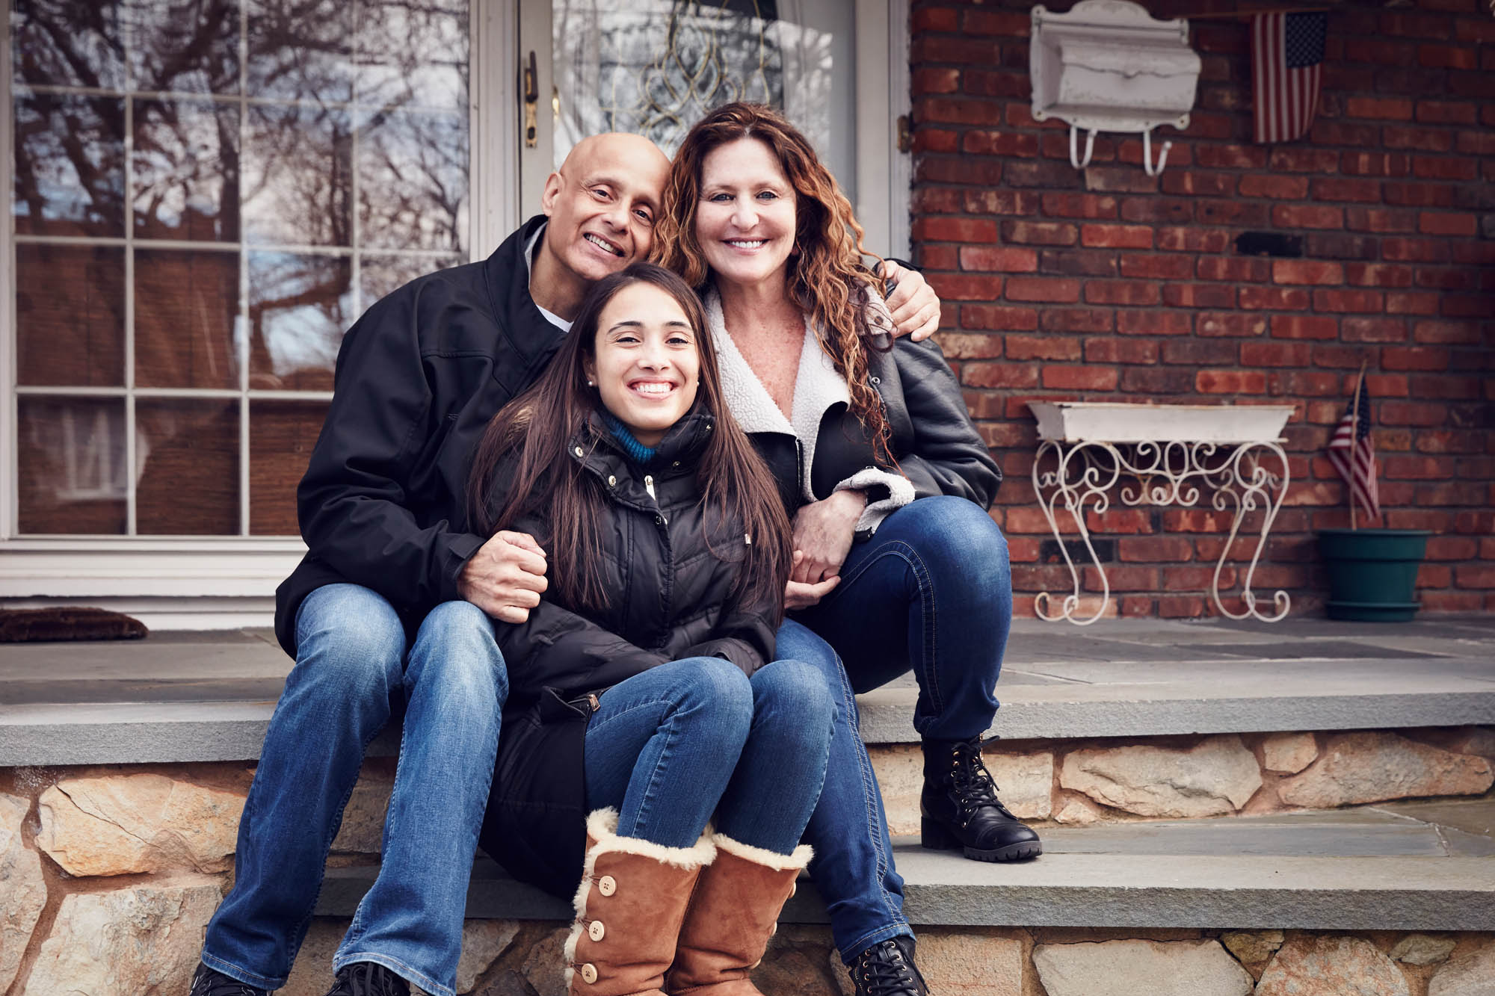
Lauren is a young mom waiting for a heart transplant. A new heart would mean more time with her daughter.
https://www.youtube.com/watch?v=DIe6bXxIK3w
Michael was an organ donor and saved 5 lives including Roxanne’s. She received Michael’s heart and honors his legacy through organ donation advocacy work.
https://www.youtube.com/watch?v=wlvwDMoAcvo
VIDEOS
Shelby received a heart transplant when she was just 10 years old. Today, she is pursuing a career as a physician's assistant to help others who are sick.
https://www.youtube.com/watch?v=TLQrGSB-jto

Slide 11
APRIL CELEBRATES THE GIFT OF LIFE
With the overwhelming loss of life experienced in the past year due to the COVID-19 pandemic, it can be difficult to remember the countless lives that have been saved. As healthcare professionals, essential workers, and caring members of our communities, we are all working to ensure the health and safety of our patients, neighbors, family and friends.
April is National Donate Life Month, a celebration of our ability to save lives through organ, eye and tissue donation. We as individuals, are empowered to give the gift of life, heal the sick and extend our generosity and kindness to others.
THE FACTS ABOUT SAVING LIVES
The quality of care you receive from medical professionals is never compromised because of your status as an organ, eye and tissue donor.
Organ donation is often possible even with certain health conditions.
There is no age limit to be an organ donor. The oldest donor in New York was 93 years old.
The organ donation process follows strict guidelines to ensure fairness and equity.
Because organ donation saves lives, most religions celebrate it as a final act of kindness and extending one's blessings.
This month, we come together as a community to raise awareness about the lifesaving power of organ, eye and tissue donation, celebrate those who have given the gift of life, and encourage others to sign up as donors. One person can save up to eight lives and leave a lasting legacy by helping others live on.
In support of the nearly 10,000 children and adults waiting for a transplant, please take a few moments to learn more about organ, eye and tissue donation and to consider signing up to save a life. Please visit LiveOnNY.org to learn more.
EMAIL & NEWSLETTER COPY

Slide 12
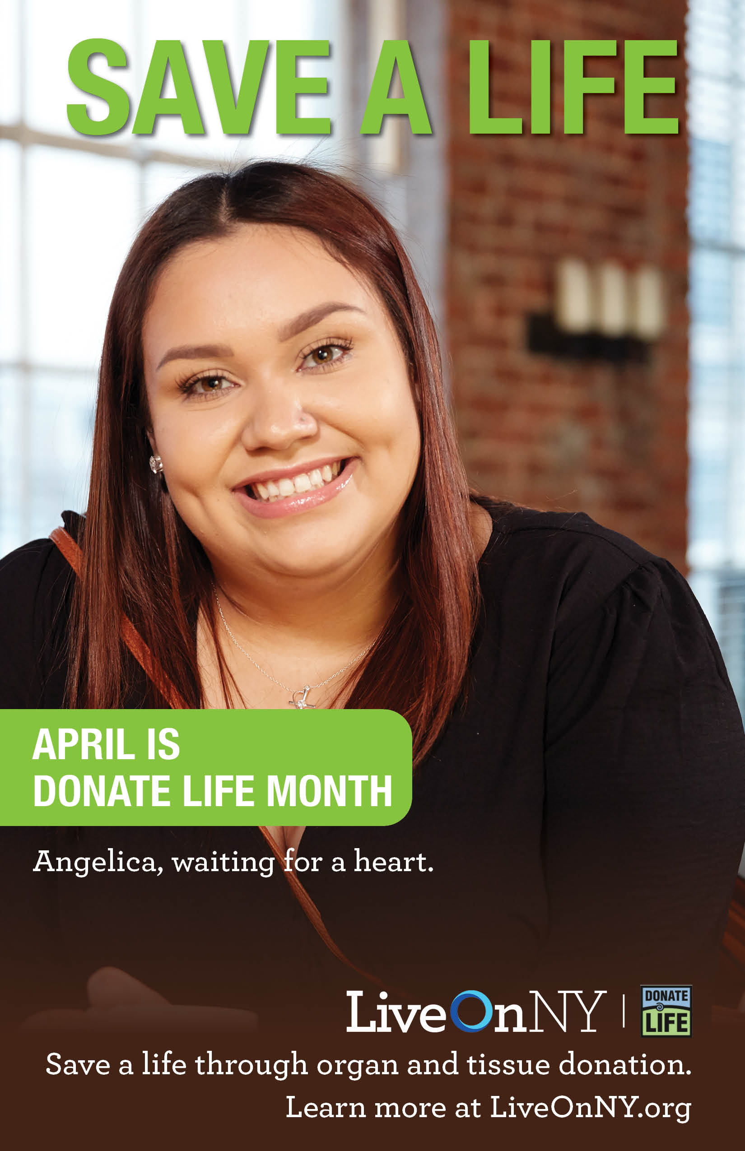
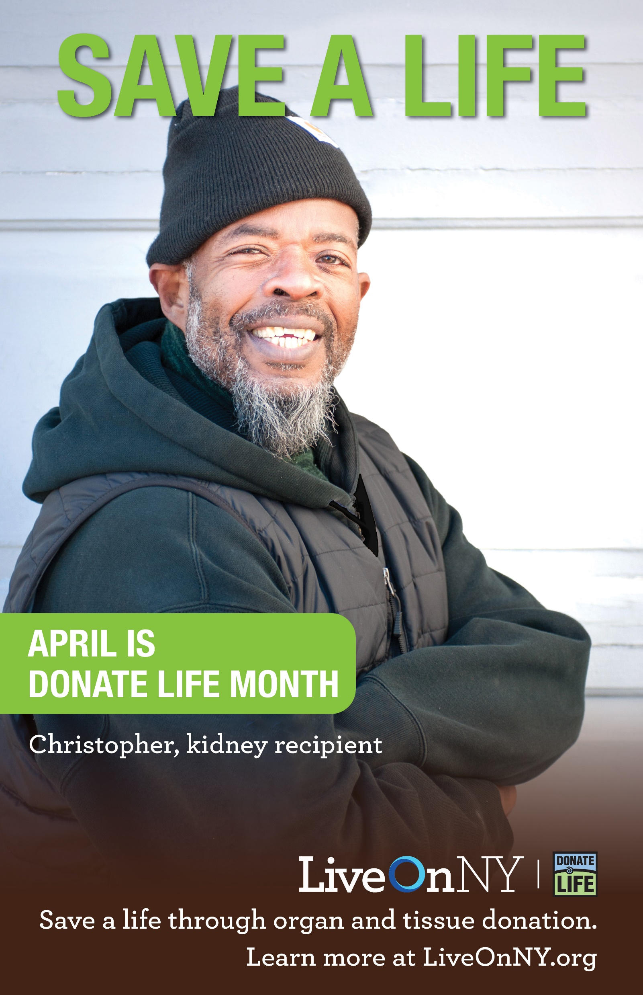
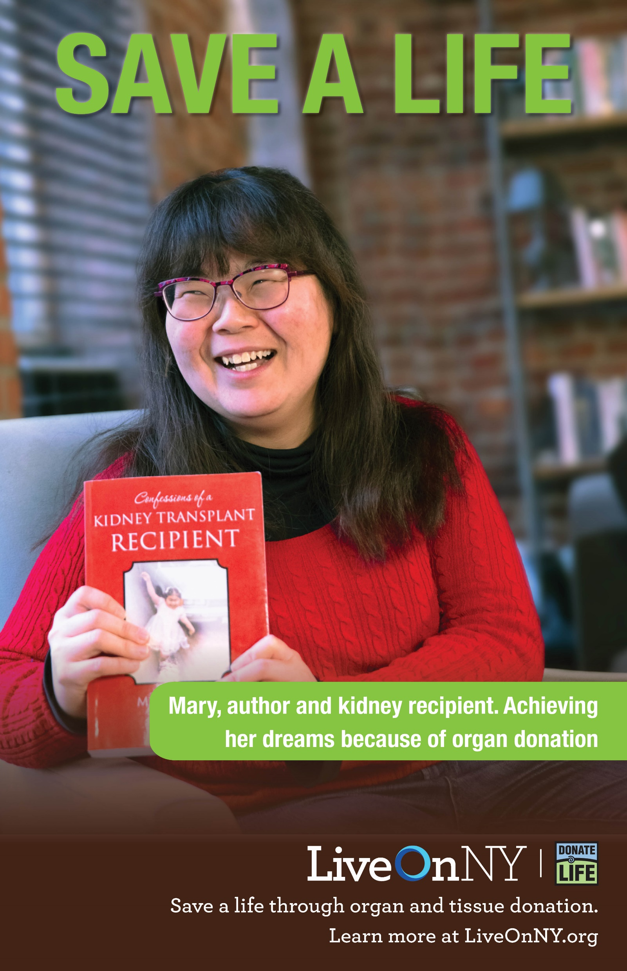
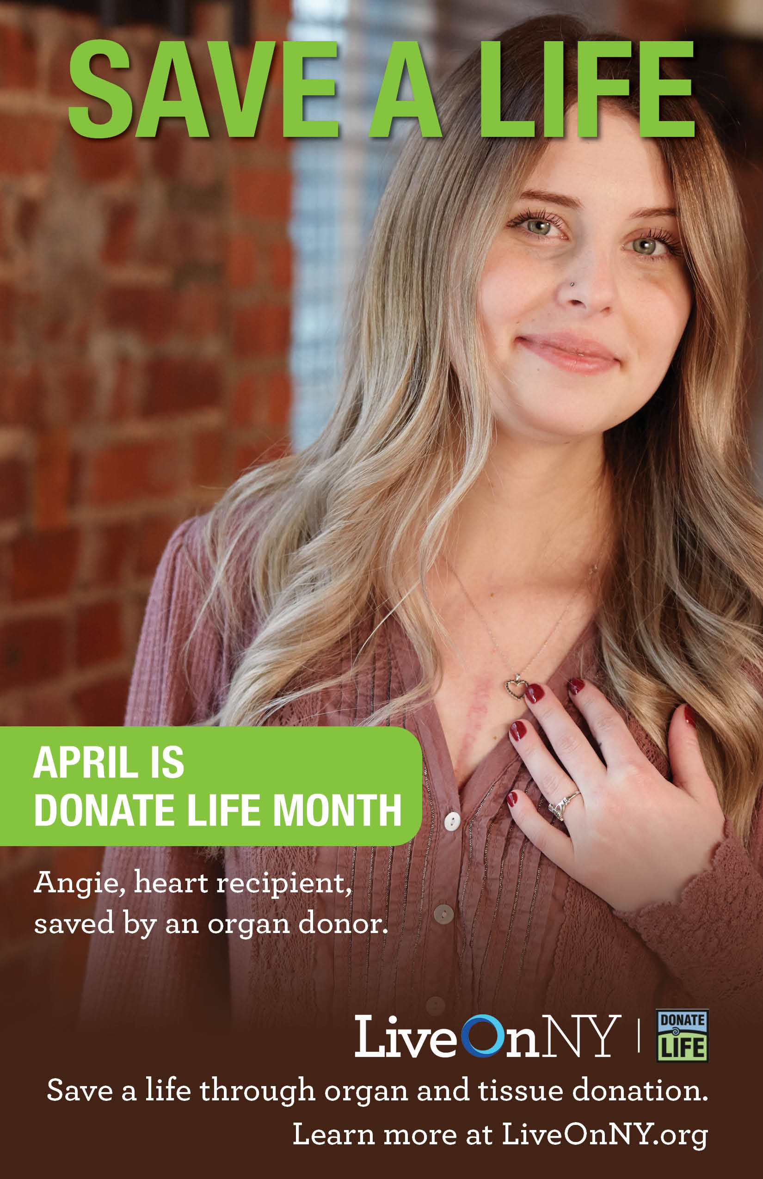
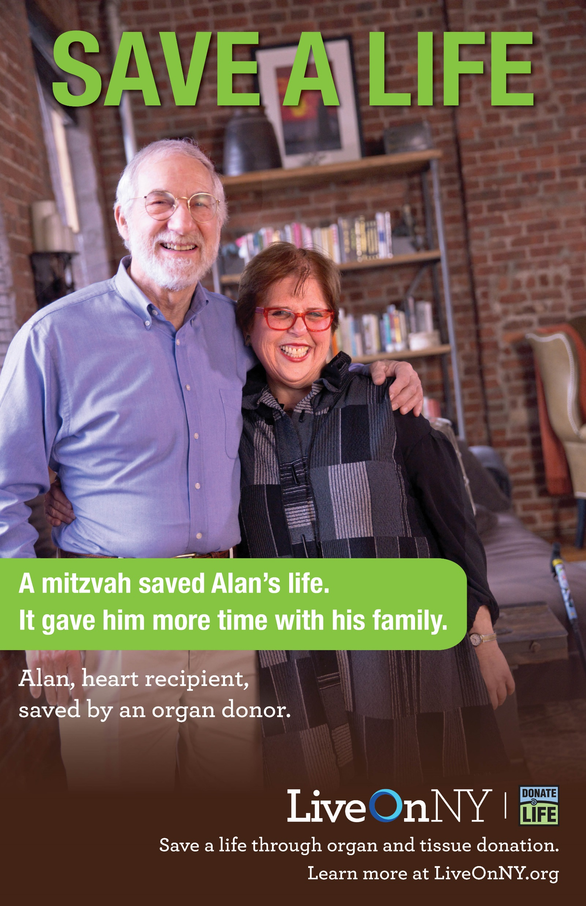
POSTERS
POSTERS

Slide 13
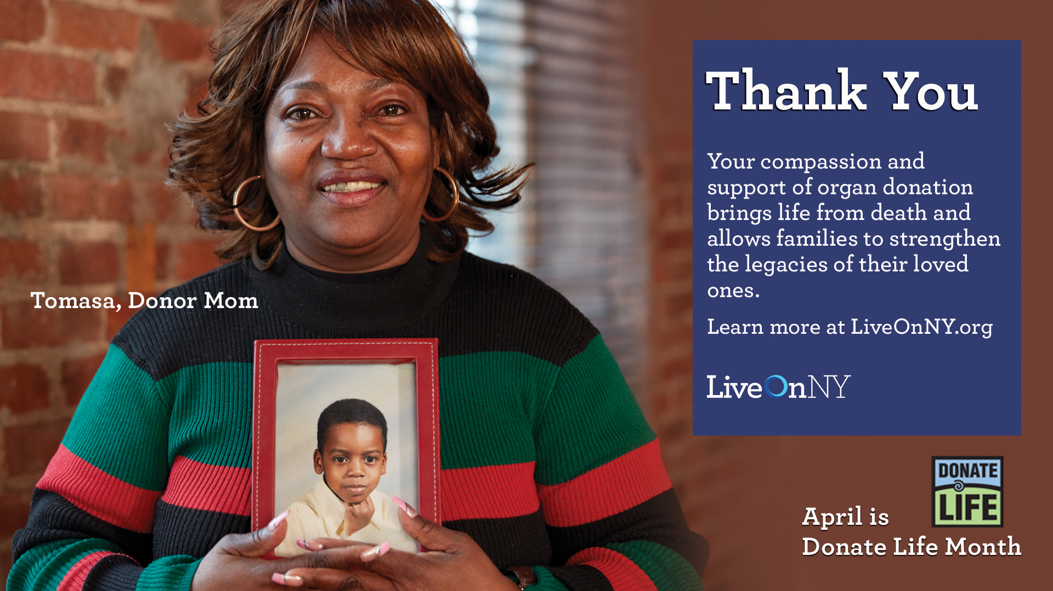
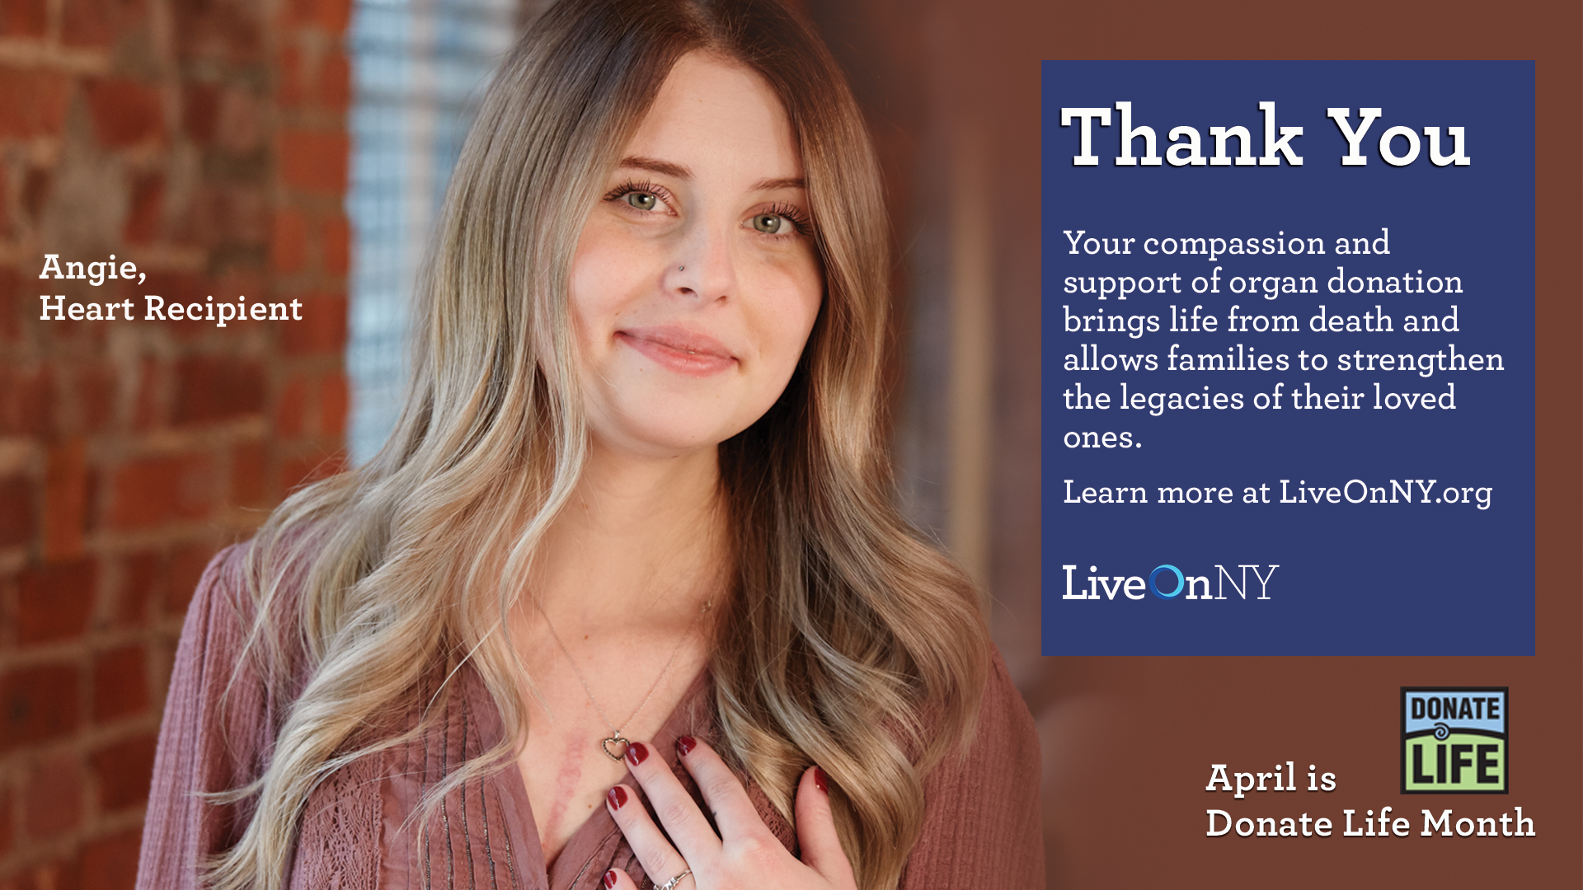
SCREENSAVERS
GRAPHICS
EMAIL SIGNATURE

Slide 14
English
Spanish
Russian
Chinese
EDUCATIONAL MATERIALS: BROCHURES
Reform
Judaism
Conservative
Judaism
Orthodox
Judaism
Catholic
Black

Slide 15
EDUCATIONAL MATERIALS
Fact Sheet
FAQs
Stat Sheet

Slide 16
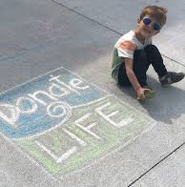
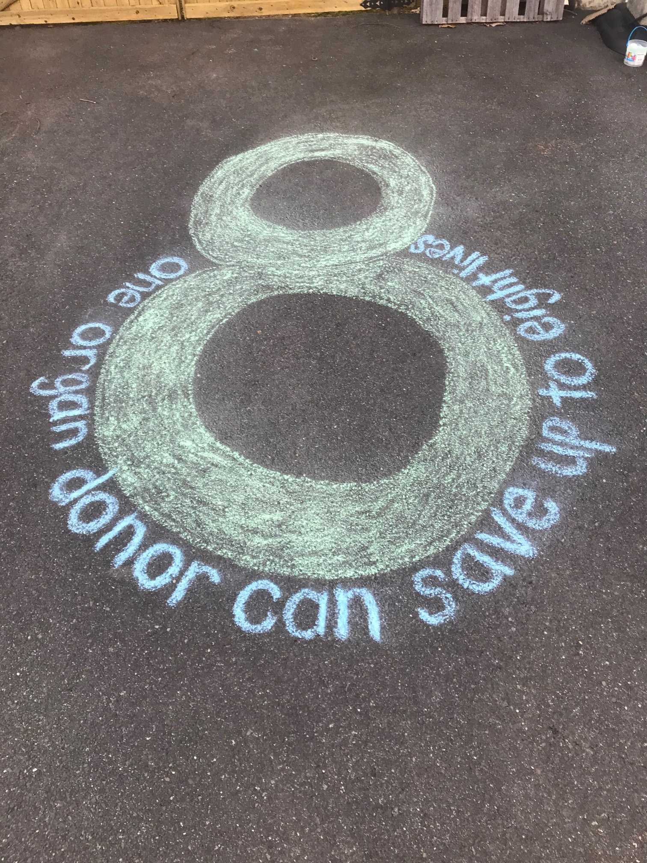
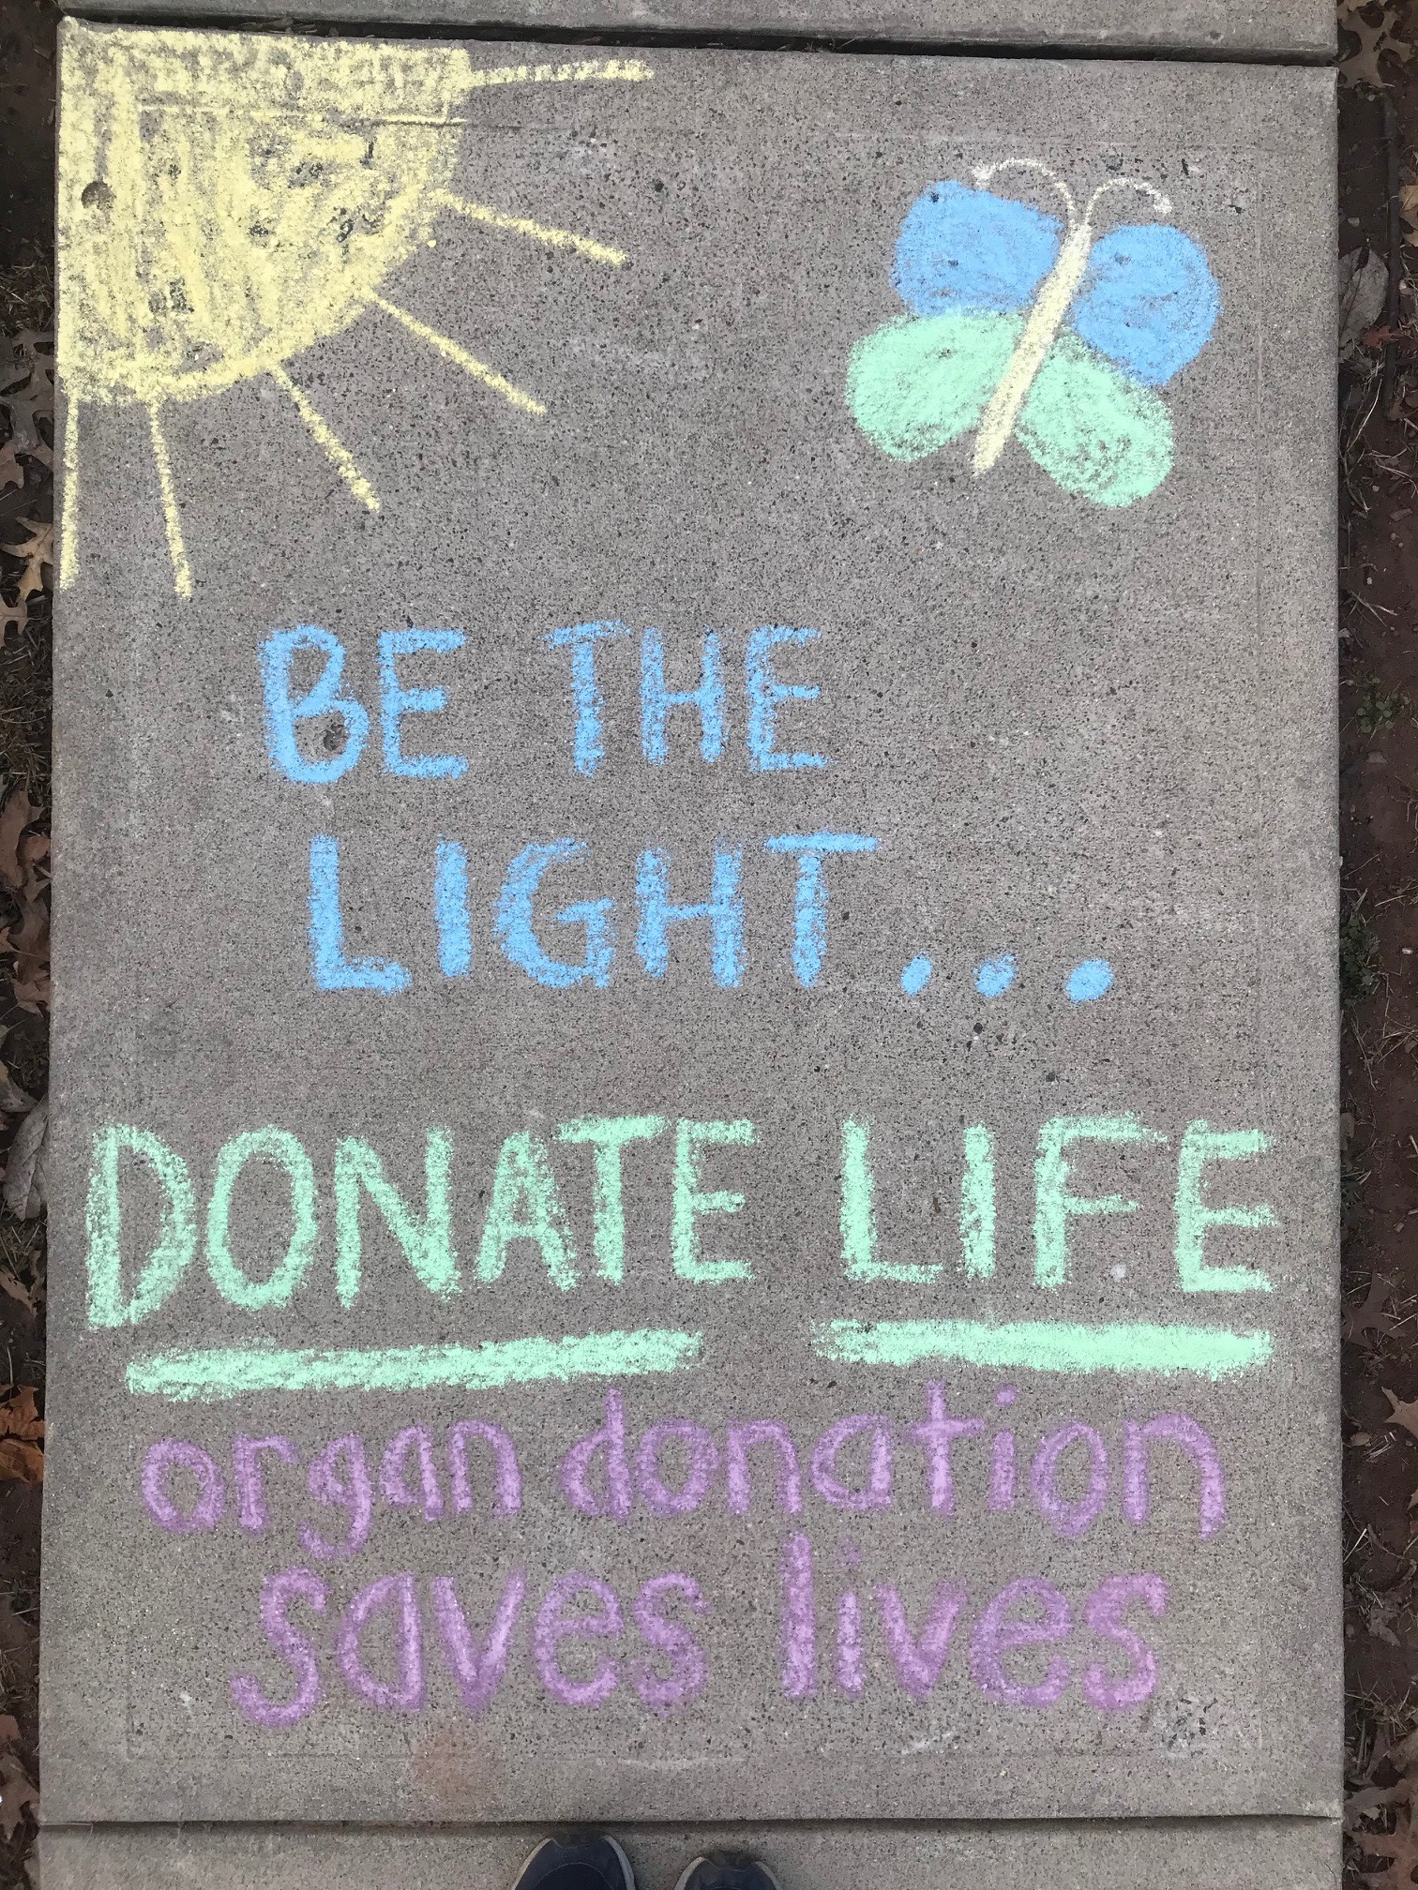
CHALK THE WALK
Donate Life Month presents an opportunity to inspire conversations about organ, eye and tissue donation. Have you ever taken notice or been inspired by chalk art around your own neighborhood? Sometimes a simple message catches your eye, sparks a conversation or inspires others.
April is your chance to get creative! We are asking partners to create blue and green chalk art on your sidewalk, driveway, building entrance or parking lot to support the message of donation.
Take a picture and share a photo by sending it to communication@liveonny.org or by tagging us on social: #LiveOnNY #DonateLifeMonth
Below are some suggested phrases that can help inspire and educate New Yorkers:
1 organ donor can save 8 lives
Organ donation saves lives
Love, Life, Legacy…Organ Donation
Donate Life | Dona Vida
Live Life. Give Life
Donate Life
Sidewalk chalk can be requested using the supply request form: https://bit.ly/3qKpbaL. All materials must be requested by March 19, 2021 in order to be shipped on time. After this date passes, sidewalk chalk can only be picked up in our offices.
ACTIVATIONS
CHALK THE WALK

Slide 17
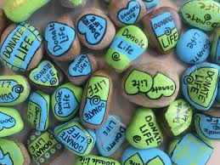
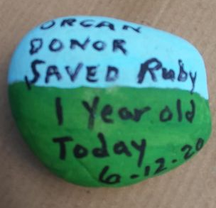
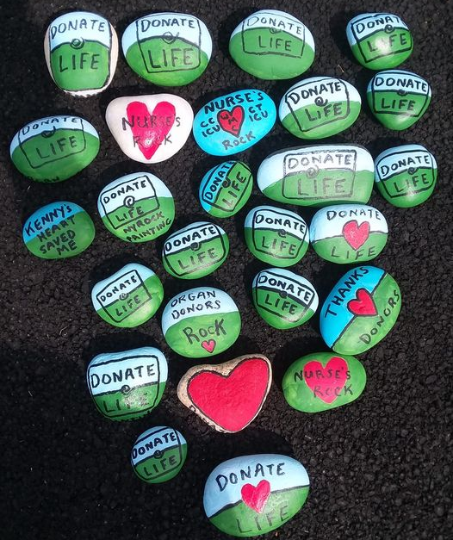
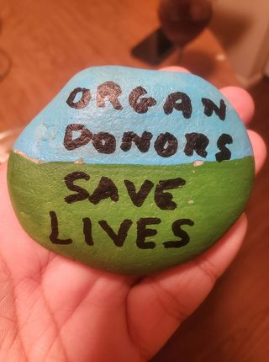
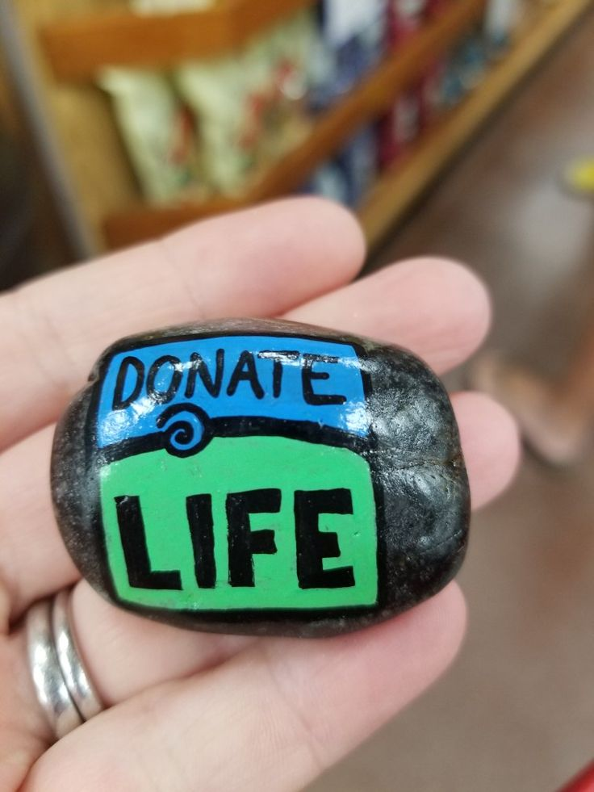
ROCK PAINTING
Sometimes it only takes a small gesture to spark an important conversation about organ and tissue donation. You are invited to join a group of donation advocates who have been leaving messages on painted rocks around New York. The hope is that the rock is found and sparks conversation. Ideally the rock is then shared on social media. During Donate Life Month, we invite you to get creative and paint your own rock. The next page provides instructions and samples to help guide you.
ACTIVATIONS
ROCK PAINTING

Slide 18
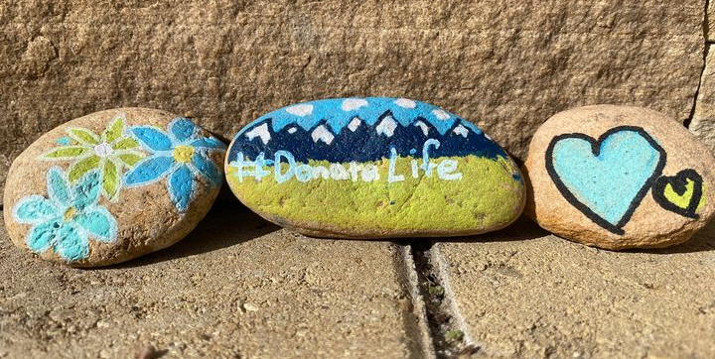
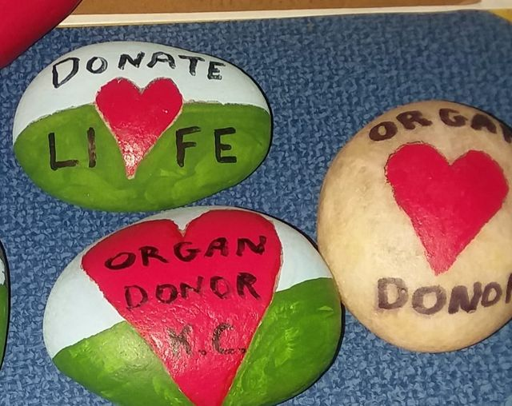
ROCK PAINTING
IN 4 EASY STEPS
STEP 1: FIND SOME ROCKS
Flat smooth rocks work best. If you live in the city, check out a local craft store or garden center as they typically sell smooth river stones. 3″ to 6″ rocks work best.
STEP 2: PAINT THE ROCKS WITH PAINT PENS
Paint pens work well to create your design and add detail. Use any artwork on the front and on the back, please include "LiveOnNY.org | Organ Donation Saves Lives" as space permits.
For painting, Sharpie Paint Pens, Prismacolor Premiere, and Posca are good options. LiveOnNY can provide the paint pens as needed. They can be requested using the link below. Paint pens must be requested using the supply request form: https://bit.ly/3qKpbaL by March 19, 2021 to be shipped. After this date passes, paint Pens must be picked up at the LiveOnNY offices.
STEP 3: TAKE A PHOTO & SHARE
Post a photo of the rock to your social media channels and tag #LiveOnNY.
STEP 4: LEAVE YOUR ROCK TO BE FOUND
Leave your rock anywhere you think it may be found. A local park, a beach, a city bench. Check out the Donate Life Rock Painting Facebook Group to see photos of rocks that have been placed and found!
ACTIVATIONS
ROCK PAINTING

Slide 19
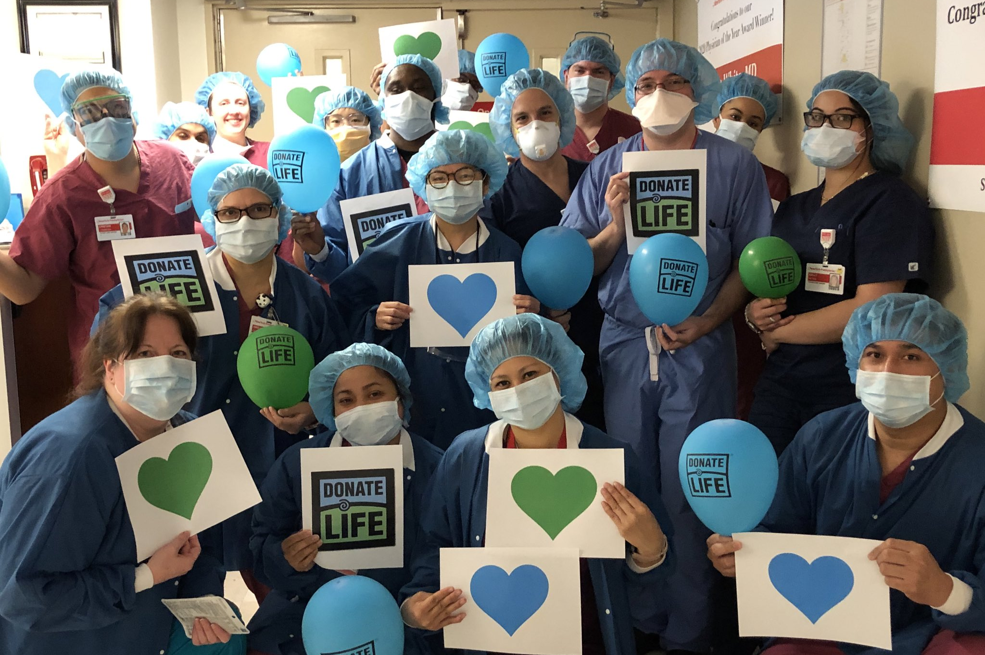
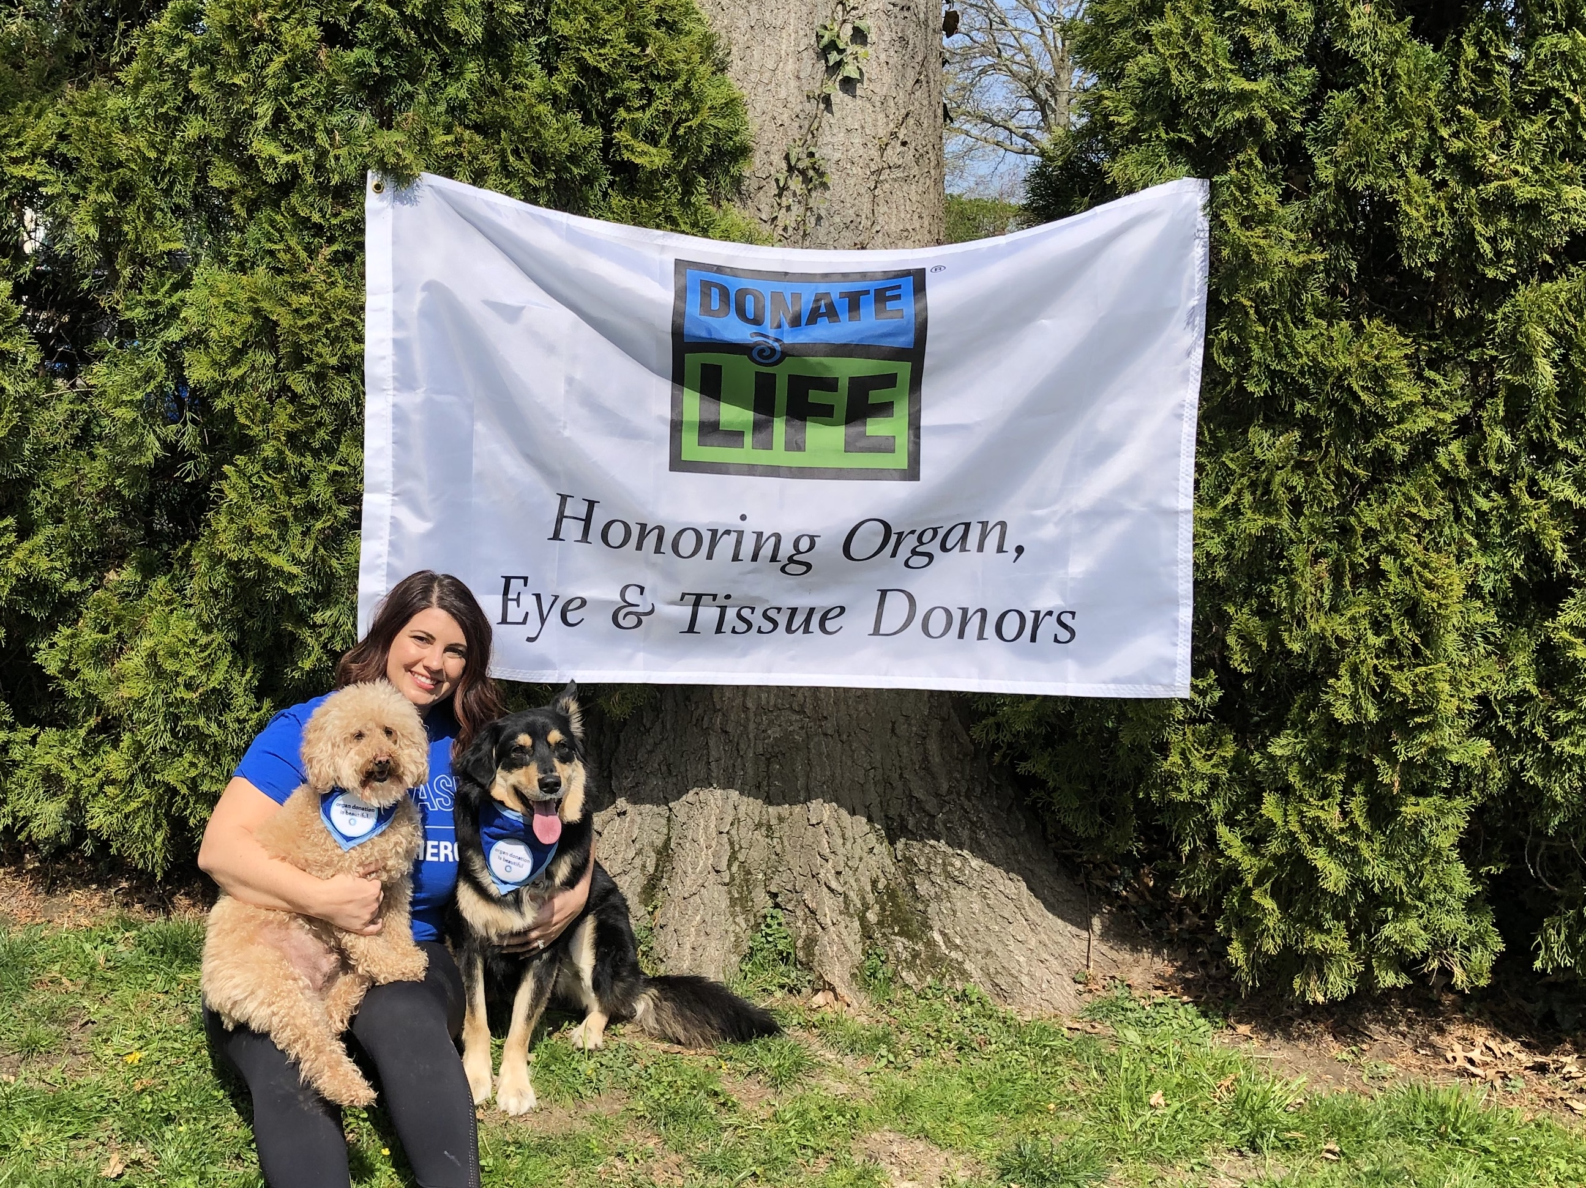
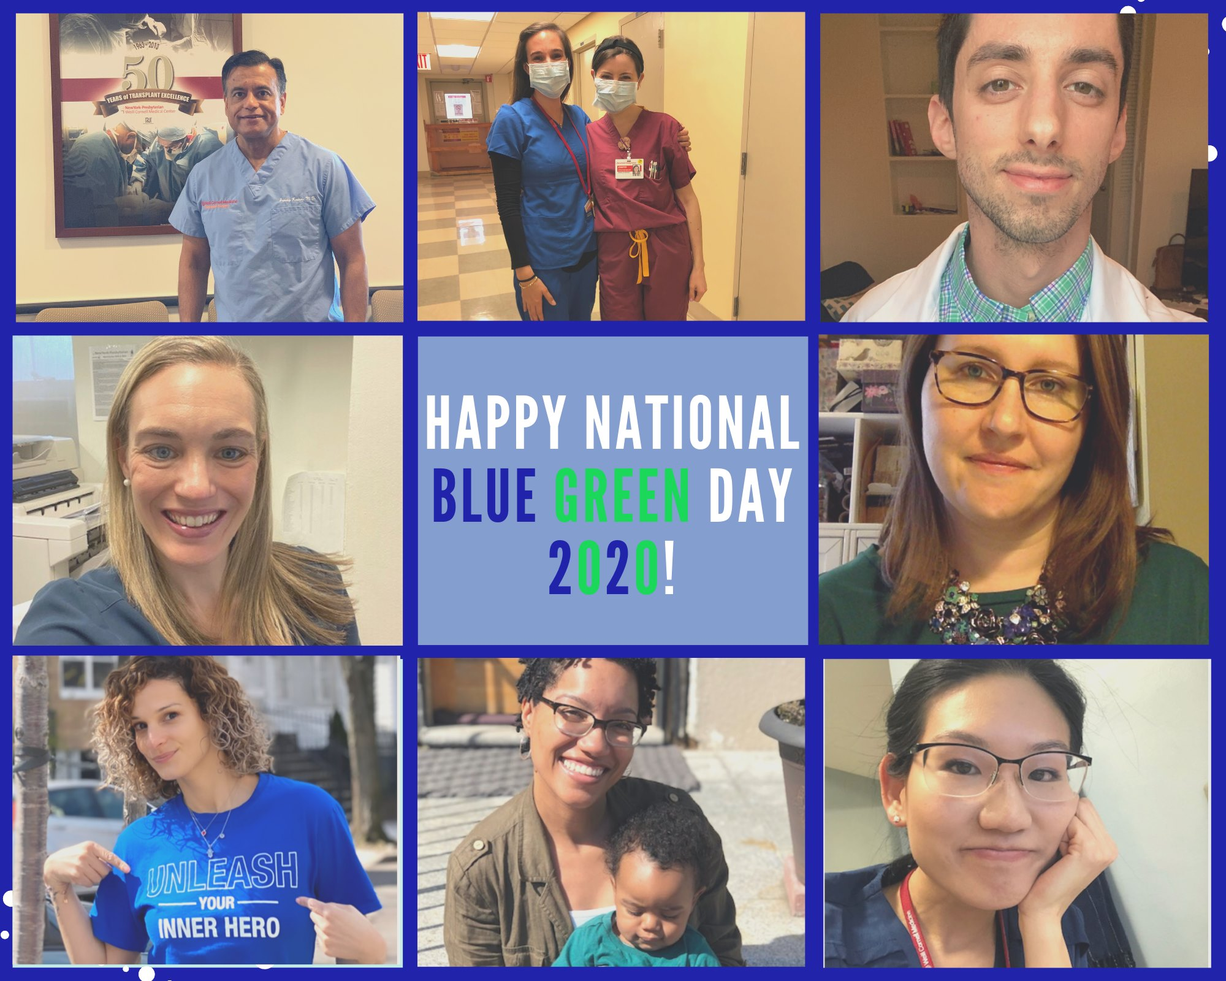
BLUE & GREEN DAY
During National Donate Life Blue & Green Day, our partners and the public are encouraged to wear blue and green and to share the organ donation message. National Donate Life Blue & Green Day is Friday, April 16, 2021. Here's how to get involved:
Post on social using the hashtags #BlueGreenDay #LiveOnNY
Have an internal competition for the best Blue & Green Day participation
Host a flag raising on this day with the blue & green Donate Life flag
ACTIVATIONS
BLUE & GREEN DAY

Slide 20
MOMENT OF GRATITUDE
On Friday, April 30, LiveOnNY will enlist members of the donation and transplantation community to observe a Moment of Gratitude in recognition of all organ, eye and tissue donors who selflessly gave the gift of life.
We are asking all partners to engage their staff in taking a moment to collectively remember donors. This can be done via a PA announcement, gathering staff in a meeting or whatever setting is most suitable for the organization. If your schedule precludes your team from doing this at the designated time, we ask that you please find a time or date that works best for you.
Please use the materials below to hold a Moment of Gratitude with your staff.
MATERIALS
Script for Moment of Gratitude to be read before the moment of silence:
Today, in recognition of Donate Life Month, we pause to pay tribute to the selfless individuals, both children and adults, who have saved lives through organ and tissue donation. On this day and in this moment, we join for a moment of gratitude -- a moment of silence to reflect upon the heroic act of donors, the courage of their families and the renewed health and happiness of those fortunate enough to receive these very precious gifts.
Poem: “We Remember Them”
We have included a call and response poem at the back of the packet that can be read at an event or flag raising, read to staff, or used in a setting that works best for your organization. For additional engagement, the larger group can join in on the bolded lines that read “We remember them.”
MOMENT OF GRATITUDE

Slide 21
MOMENT OF GRATITUDE: POEM
We Remember Them
(a poem of call and response)
Reader: In the rising of the sun and in its going down, Audience: we remember them.
Reader: In the blowing of the wind and in the chill of winter, Audience: we remember them.
Reader: In the opening of buds and in the rebirth of spring, Audience: we remember them.
Reader: In the blueness of the sky and in the warmth of summer, Audience: we remember them.
Reader: In the rustling of leaves and in the beauty of autumn, Audience: we remember them.
Reader: In the beginning of the year and when it ends, Audience: we remember them.
Reader: When we are weary and in need of strength, Audience: we remember them.
Reader: When we are lost and sick at heart, Audience: we remember them.
Reader: When we have joys we yearn to share, Audience: we remember them.
Reader: So long as we live, they too shall live, for they are now a part of us, as Audience: we remember them.
MOMENT OF GRATITUDE

Slide 22
MOMENT OF GRATITUDE: SOCIAL MEDIA
Use the following social media post on April 30th. Please schedule the post to run at 3pm EST. Feel free to post your own messages in the days leading up to the Moment of Gratitude. Please use the hashtags #MomentOfGratitude #LiveOnNY so LiveOnNY can track participation. LiveOnNY will post our internal Moment of Gratitude on our Facebook page (@LiveOnNewYork) for any organizations that wish to share it.
FACEBOOK:
Today, in recognition of Donate Life Month, join us in pausing to pay tribute to the selfless individuals, both children and adults, who have saved lives through organ and tissue donation. We share a moment of gratitude to reflect upon the heroic act of donors, the courage of their families and the renewed health and happiness of those fortunate to receive these very precious gifts. #MomentOfGratitude #LiveOnNY
MOMENT OF GRATITUDE
TWITTER:
Today we pause to honor the heroic act of organ and tissue donors and their families. They left a powerful legacy. #MomentOfGratitude #LiveOnNY

Slide 23
MOMENT OF GRATITUDE: E-MAIL TEMPLATE
Please use this email template to inform your staff about the Moment of Gratitude.
Dear Colleagues,
[INSERT HOSPITAL/ORGANIZATION NAME] is proud to participate in Donate Life Month, which occurs every April and is dedicated to raising awareness about the power of organ, eye and tissue donation. Organ donation is a heroic and beautiful act that can save the lives of up to eight people. Organ donors and their families are selfless individuals who chose to give the ultimate gift so that others may have a second chance at life.
This month, medical professionals across the metropolitan area will be joining LiveOnNY and other organizations in observing a collective moment of gratitude in recognition of all the heroic organ donors. Please join us in this remembrance at [INSERT LOCATION, CLARIFY IF THIS WILL BE DONE OVER THE PA SYSTEM, OR IN A HUDDLE] on Friday, April 30. If your schedule precludes you from participating at the designated date, please find time on your own during the month of April to gather a few colleagues and take a moment to say thank you.
Thank you for joining to say thank you to organ donors.
Sincerely,
[INSERT NAME HERE]
MOMENT OF GRATITUDE

Slide 24
GET CREATIVE
EDUCATION IDEAS
Message from the CEO
(email, video posted to intranet, tweet)
Host an educational webinar
Have an Instagram takeover, have a twitter chat
Rounding, education and sharing information in breakrooms, on units

Slide 25
Questions? Contact Scott Wohl at swhol@liveonny.org.
THANK YOU!

