Slide 1
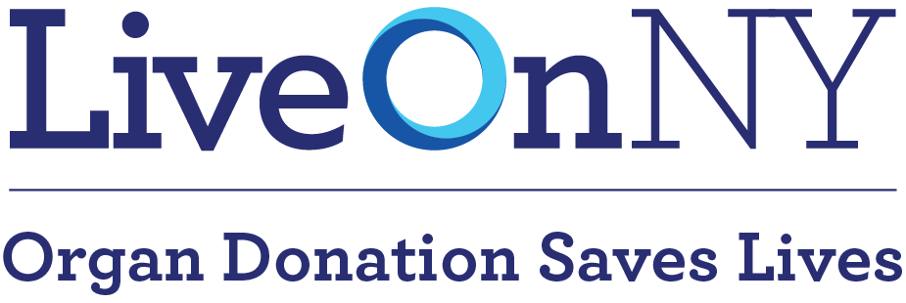
Unleash your inner hero!
DONATE LIFE MONTH 2023
A DIGITAL TOOLKIT

Slide 2
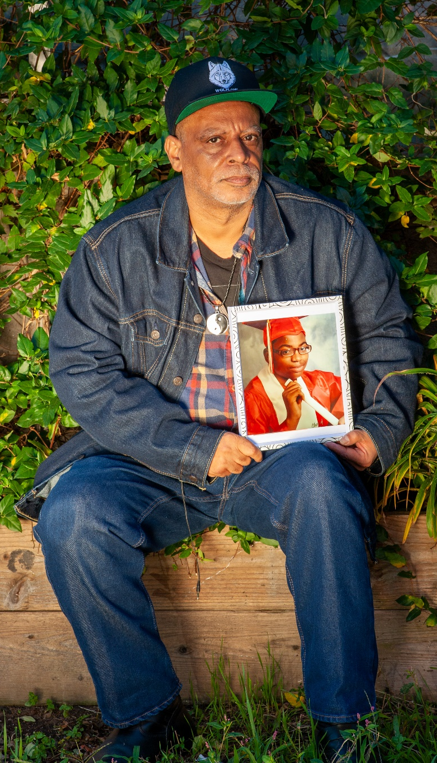
Donate Life Month with LiveOnNY
New Yorkers are stepping up in amazing and profound ways to save lives through organ, eye and tissue donation. This remarkable act of kindness and generosity by donor heroes and their families leaves a lasting legacy, creates a generational impact and has given thousands the opportunity to celebrate more birthdays, spend more time with loved ones, and do amazing things with their second chance at life.
Because of the generosity of the New York Community , over 1,300 organs were transplanted in 2022 - the most ever in our service area in one year thanks to the selfless decisions made by organ and tissue donors and their families.
This Donate Life Month, help LiveOnNY amplify our mission to save more lives by using the messaging, tools and copy in the toolkit provided below. By helping to amplify the message of donation, you help inspire even more conversations about donation and help save more lives Thank you for your continued support for our life saving mission.
Eddie, father of Donor Hero, Nicholas

Slide 3
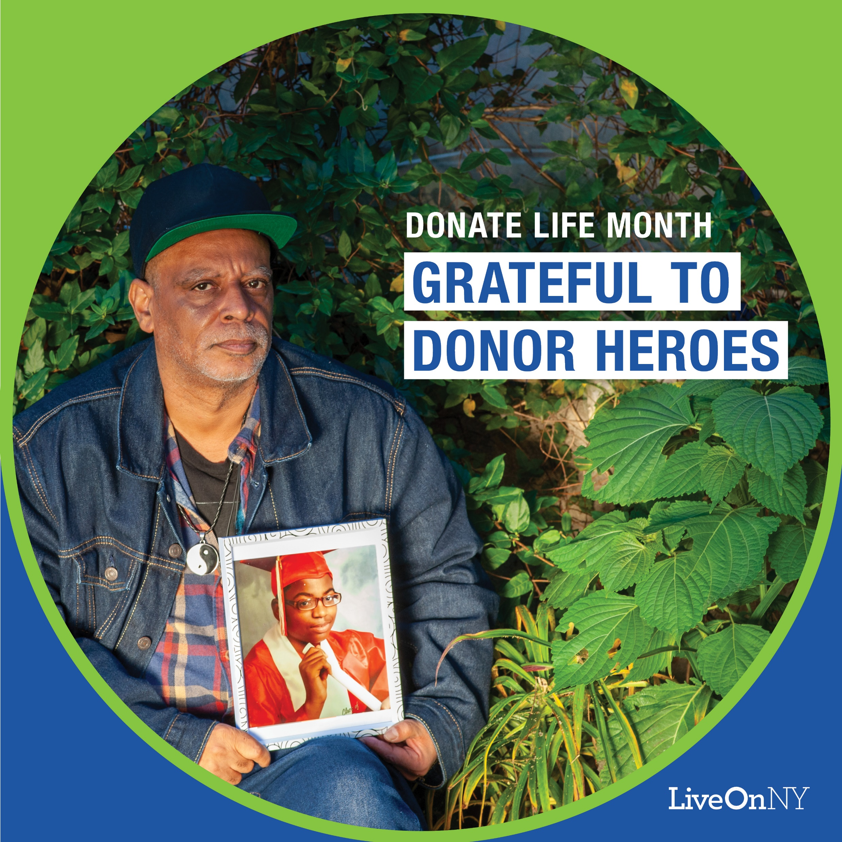
INSTAGRAM/FACEBOOK/TWITTER
SOCIAL MEDIA
#DonateLifeMonth #LiveOnNY
Sample supporting text for graphics provided
This #DonateLifeMonth, talk to your family about your #organdonation wishes. Learn more at LiveOnNY.org #DonateLifeMonth #LiveOnNY
It takes an incredible network of people to make donation and transplantation possible. To all the healthcare heroes working tirelessly to save lives through organ, eye and tissue donation, and transplantation, thank you. #DonateLifeMonth #LiveOnNY
We honor FDNY FF Moon for saving 5 lives as an organ donor. Consider FF Moon’s example as an #organdonor and sign up in his honor to save lives at LiveOnNY.org. #DonateLifeMonth #LiveOnNY #DonorSalute
National Donate Life Blue & Green Day is on Friday, April 14. Show your support for organ and tissue donation by rocking blue & green colors. Share your photos with us by tagging #LiveOnNY and #BlueGreenDay #DonateLifeMonth
One organ donor can save up to eight lives and improve the lives of more than 75 people. Sign up at LiveOnNY.org. #DonateLifeMonth #LiveOnNY

Slide 4
APRIL CELEBRATES THE GIFT OF LIFE
New Yorkers are stepping up in amazing and profound ways to save lives through organ, eye, and tissue donation. This remarkable act of kindness and generosity by donors and their families leaves a lasting legacy and has given thousands the opportunity to celebrate more birthdays, spend more time with loved ones, and do amazing things with their second chance at life.
But our families, friends, neighbors, and coworkers still need our help. There are nearly 8,000 New Yorkers on the transplant waiting list. When we say “yes” to donation as part of our end-of-life wishes, we are agreeing to be organ donor heroes who leave a lifesaving legacy.
April is National Donate Life Month, a celebration of our ability to save lives through organ, eye and tissue donation. We pay tribute to our donor heroes and empower ourselves to give the gift of life, heal the sick and extend our generosity and kindness to others.
THE FACTS ABOUT SAVING LIVES
The quality of care you receive from medical professionals is never compromised because of your status as an organ, eye and tissue donor.
Organ donation is often possible even with certain health conditions.
There is no age limit to be an organ donor. The oldest donor in New York was 93 years old.
The organ donation process follows strict guidelines to ensure fairness and equity.
Because organ donation saves lives, major religions celebrate it as a final act of kindness and extending one's blessings.
In support of the nearly 8,000 children and adults waiting for a transplant, please take a few moments to learn more about organ, eye and tissue donation. Talk with your loved ones about your final wishes and consider signing up to save a life. Please visit LiveOnNY.org to learn more.
EMAIL COPY

Slide 5
April is Donate Life Month, an opportunity to honor those who gave the gift of life through organ, eye, and tissue donation. Earlier this year, FDNY Fire Fighter William Moon, tragically died while conducting a training exercise. His final act was to give the gift of life to others in need. He saved five lives through organ donation and inspired countless others to learn more about organ donation. This month we pay tribute to him and all organ donor heroes.
On behalf of the nearly 8,000 New Yorkers still waiting for a lifesaving transplant, please consider learning more about organ, eye and tissue donation by visiting LiveOnNY.org. Discuss your donation wishes with your family and consider signing up to be a lifesaving donor hero.
SHORT FORM NEWSLETTER CONTENT

Slide 6
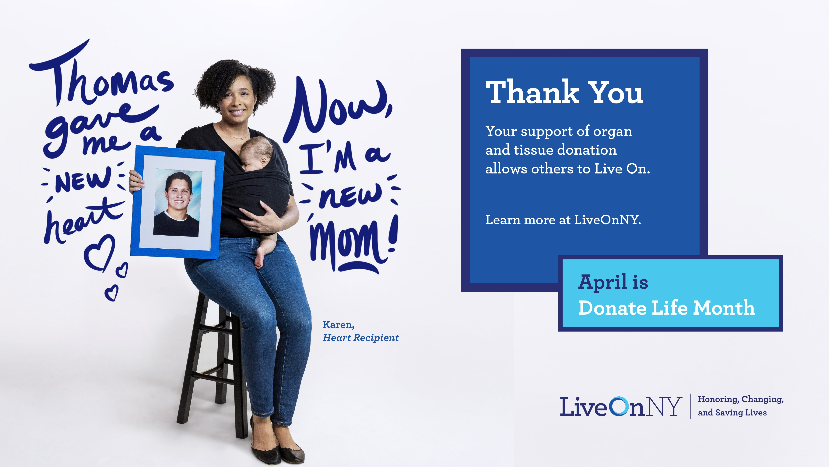
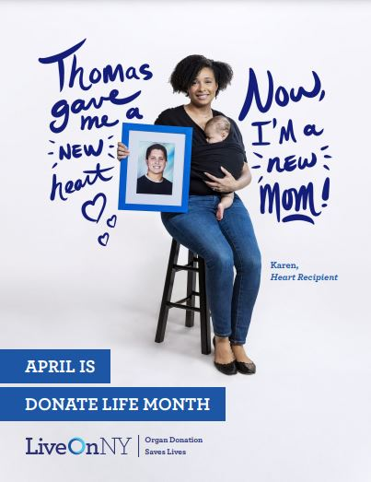
SCREENSAVER
POSTER
GRAPHICS

Slide 7
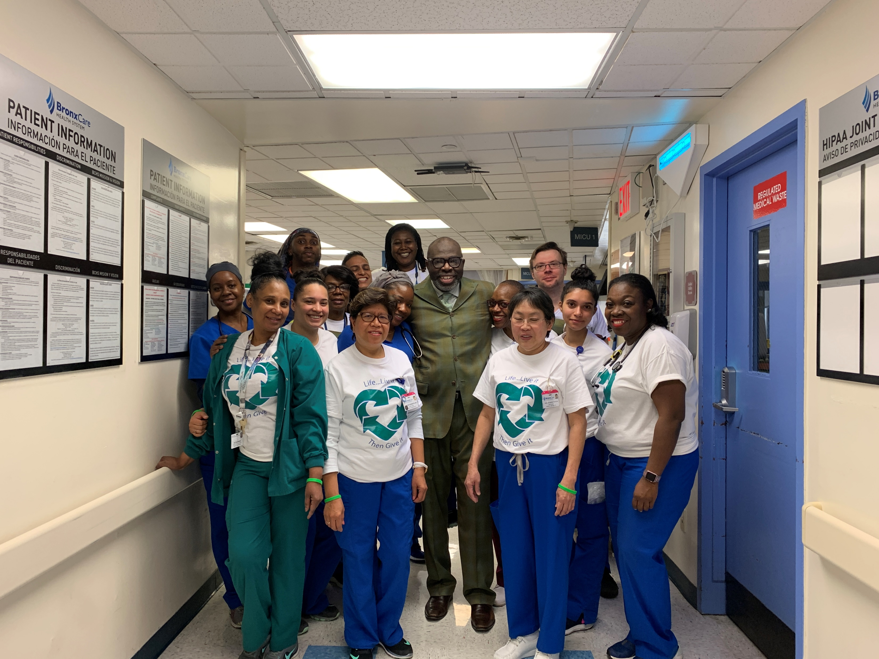
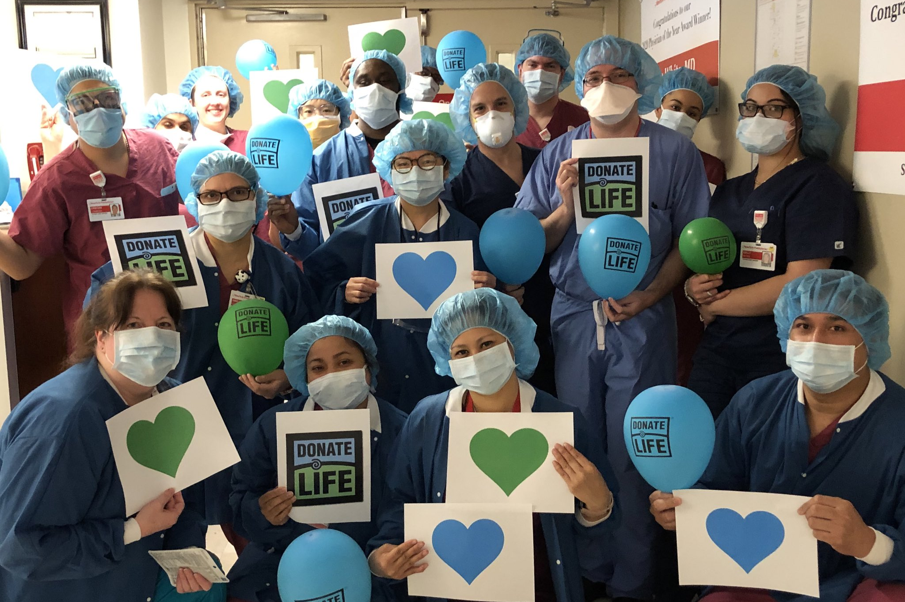
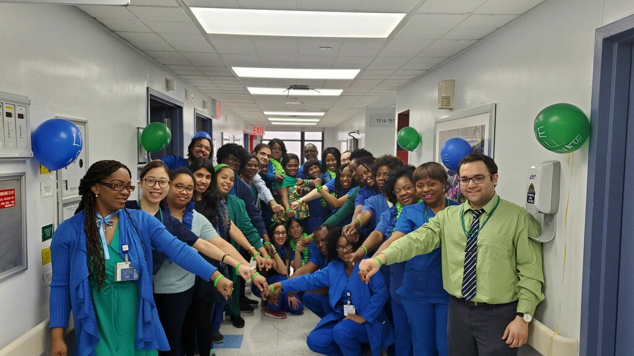
BLUE & GREEN DAY
During National Donate Life Month's Blue & Green Day, our partners and the public are encouraged to wear blue and green and to share the organ donation message. National Donate Life Blue & Green Day is Friday, April 14, 2023.
For Blue & Green Day: Friday, April 14th
Post on social using the hashtags #BlueGreenDay #LiveOnNY
Have an internal competition for the best Blue & Green Day participation
Host a flag raising on this day with the blue LiveOnNY Flag
ACTIVATIONS
BLUE & GREEN DAY

Slide 8
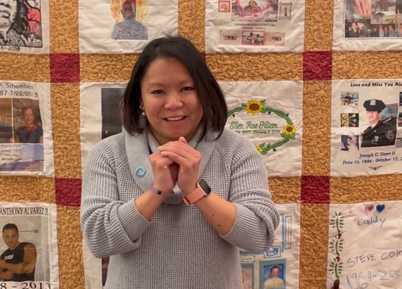
MOMENT OF GRATITUDE
Throughout the month of April, LiveOnNY will enlist members of the donation and transplantation community to observe a Moment of Gratitude in recognition of all organ, eye and tissue donors who selflessly gave the gift of life.
We are asking all partners to engage their staff in taking a moment to collectively remember the donors. This can be done via a PA announcement, gathering staff in a meeting or whatever setting is most suitable for the organization.
MATERIALS
Script for Moment of Gratitude to be read before the moment of silence:
Today, in recognition of Donate Life Month, we pause to pay tribute to the selfless individuals, both children and adults, who have saved lives through organ and tissue donation. On this day and in this moment, we join for a moment of gratitude -- a moment of silence to reflect upon the heroic act of donors, the courage of their families and the renewed health and happiness of those fortunate enough to receive these very precious gifts.
Poem: “We Remember Them”
We have included a call and response poem on LiveOnNY's Donate Life Month website that can be read at an event or flag raising, read to staff, or used in a setting that works best for your organization. For additional engagement, the larger group can join in on the bolded lines that read “We remember them.”
Poem copy is available here: www.LiveOnNY.org/donate-life-month.
MOMENT OF GRATITUDE

Slide 9
MOMENT OF GRATITUDE: SOCIAL MEDIA
Use the following social media posts on any date in April. Please use the hashtags #MomentOfGratitude #LiveOnNY so LiveOnNY can track participation.
FACEBOOK:
Today, in recognition of Donate Life Month, join us in pausing to pay tribute to the selfless individuals, both children and adults, who have saved lives through organ and tissue donation. We share a moment of gratitude to reflect upon the heroic act of donor heroes, the courage of their families and the renewed health and happiness of those fortunate to receive these very precious gifts. #MomentOfGratitude #LiveOnNY
MOMENT OF GRATITUDE
TWITTER:
Today we pause to honor the heroic act of organ and tissue donor heroes and their families. They left a powerful legacy. #MomentOfGratitude #LiveOnNY

Slide 10
Questions? Contact Scott Wohl at swohl@liveonny.org.
THANK YOU!

